Slide 1
Bibliometric Analysis on Cancer Cachexia Using Bibliometrix
By:
Radhika Gedela
Data Visualization Intern
Indiana Center for Musculoskeletal Health, IUI
Under the Guidance of:
Thomas O’Connell

Slide 2
WHAT IS BIBLIOMTERIC ANALYSIS
Bibliometric Analysis is a quantitative method used to analyze scientific literature by examining publication patterns, citation relationships, and research trends.
Key Metrics:
Citation Counts: Tracks how often a publication is cited, indicating its influence.
Co-authorship Analysis: Studies collaboration patterns among authors and institutions.
Keyword Analysis: Identifies core themes and evolving research topics.
Network Mapping: Visualizes relationships between authors, keywords, and institutions.
Importance of Bibliometric Analysis
Reveals under-explored areas.
Evaluates influence of key papers and authors.
Highlights emerging topics and shifts in research focus.
Data-driven support for decision-making in research priorities.

Slide 3
Data Collection
Comprehensive bibliometric analysis conducted using the Web of Science database.
SEARCH CRITERIA:
Search Terms "Cancer AND cachexia" used to focus on relevant literature, ensuring specificity in the collected data.
Exclusion Criteria Review articles omitted to concentrate on primary research contributions to the field.
1
2
Time Frame Publications from 2003 to 2023 included, providing a comprehensive 20-year analysis period.
3
Language Restriction English-language publications only, maintaining consistency in analysis and interpretation.
4

Slide 4
Bibliometrix Tool Used
Bibliometrix: A comprehensive R-tool for quantitative research in bibliometrics.
Used for detailed analysis of the dataset, including trends, citation analysis, and author collaborations.
CiteSpace: A tool for visualizing and analyzing trends and patterns in scientific literature.
Focuses on co-citation analysis and cluster detection.

Slide 5
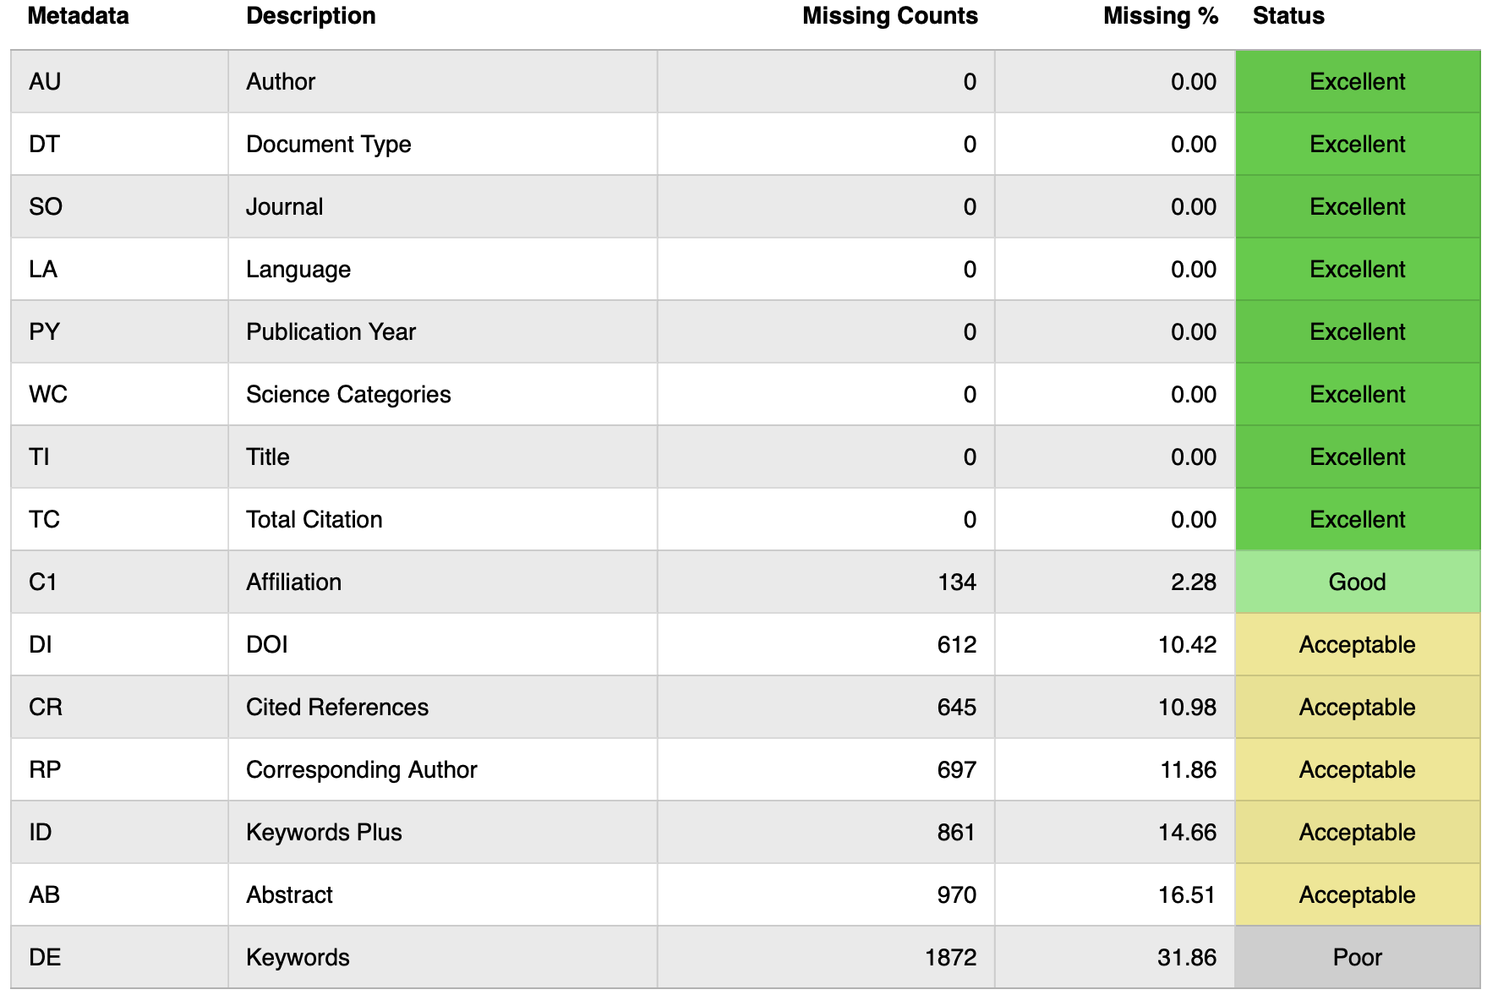
Analysis of Results from Bibliometrix
Metadata Completeness Evaluation
Following the import of 5,875 records from Web of Science into Bibliometrix, a comprehensive examination of metadata completeness was performed.
Notes:
The metadata completeness assessment for the 5,875 documents from ISI indicates that key fields such as author, document type, journal, language, publication year, and title are complete with no missing values, demonstrating excellent data quality. However, several fields show significant missing data, particularly in keywords (31.86%), abstracts (16.51%), and corresponding authors (11.86%), which may affect the depth of analysis and insights derived from the dataset. Overall, while the dataset is strong in core bibliographic details, the lack of completeness in certain metadata fields suggests areas for improvement to enhance the richness of the analysis.

Slide 6
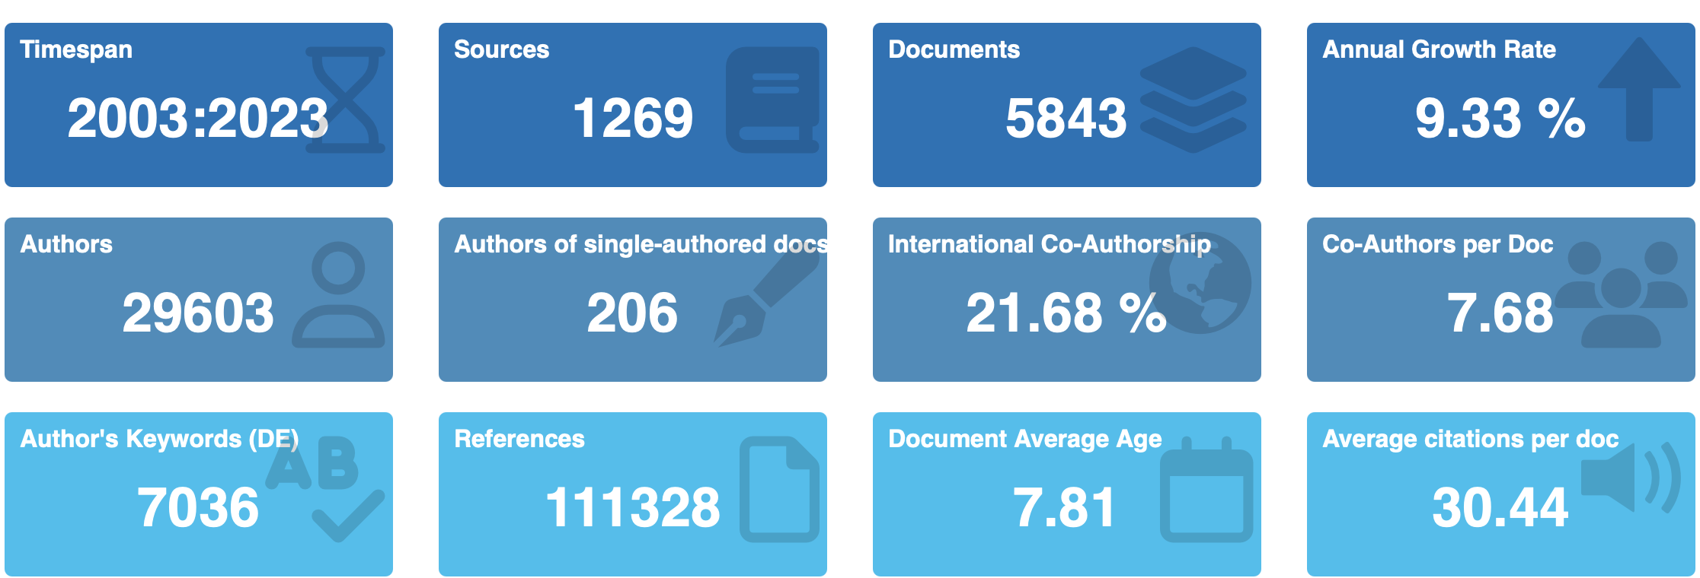
Bibliometrix - Main Information

Slide 7
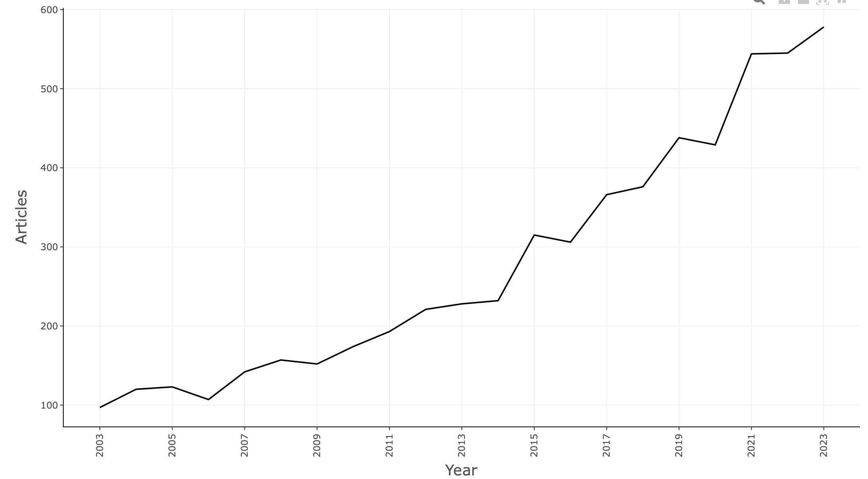
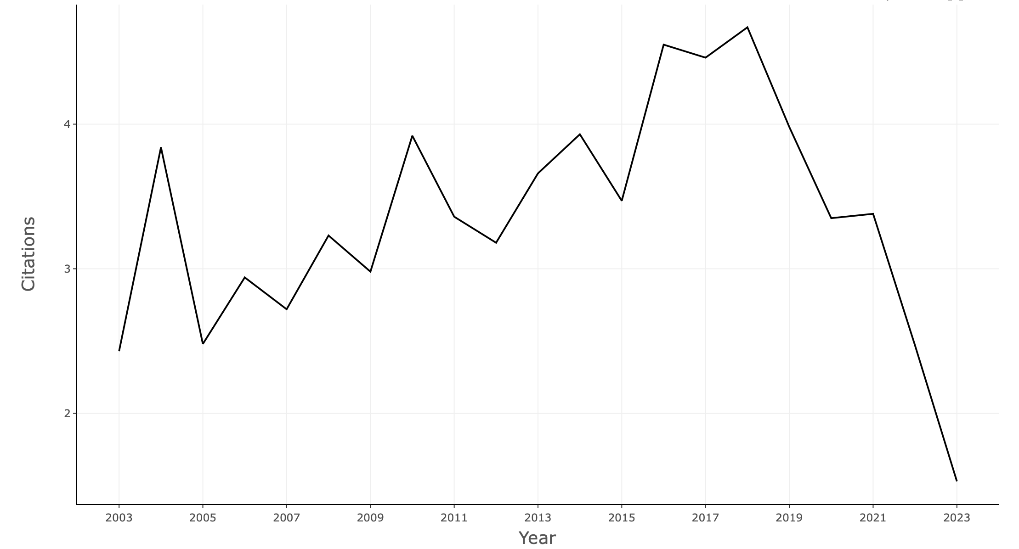
Annual scientific production
Average Citations per Year

Slide 8
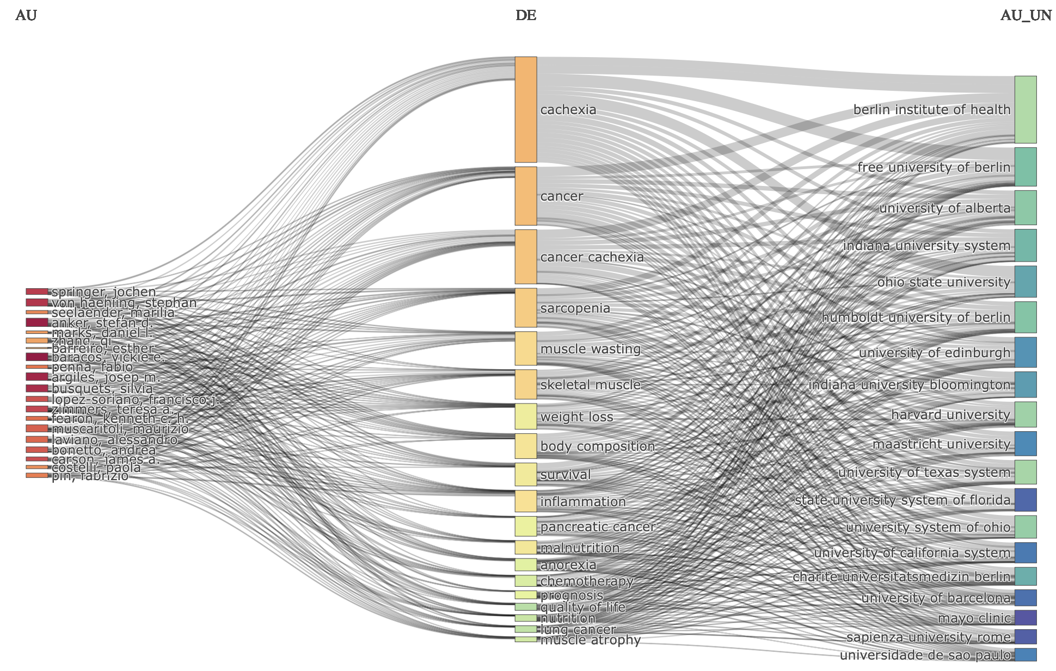
Three Field Plot
Left Field (Authors): Identifies key researchers in the field.
Middle Field (Keywords): Connects researchers to primary topics studied.
Right Field (Sources/Journals): Shows where research is published, linking authors and topics to specific journals.

Slide 9
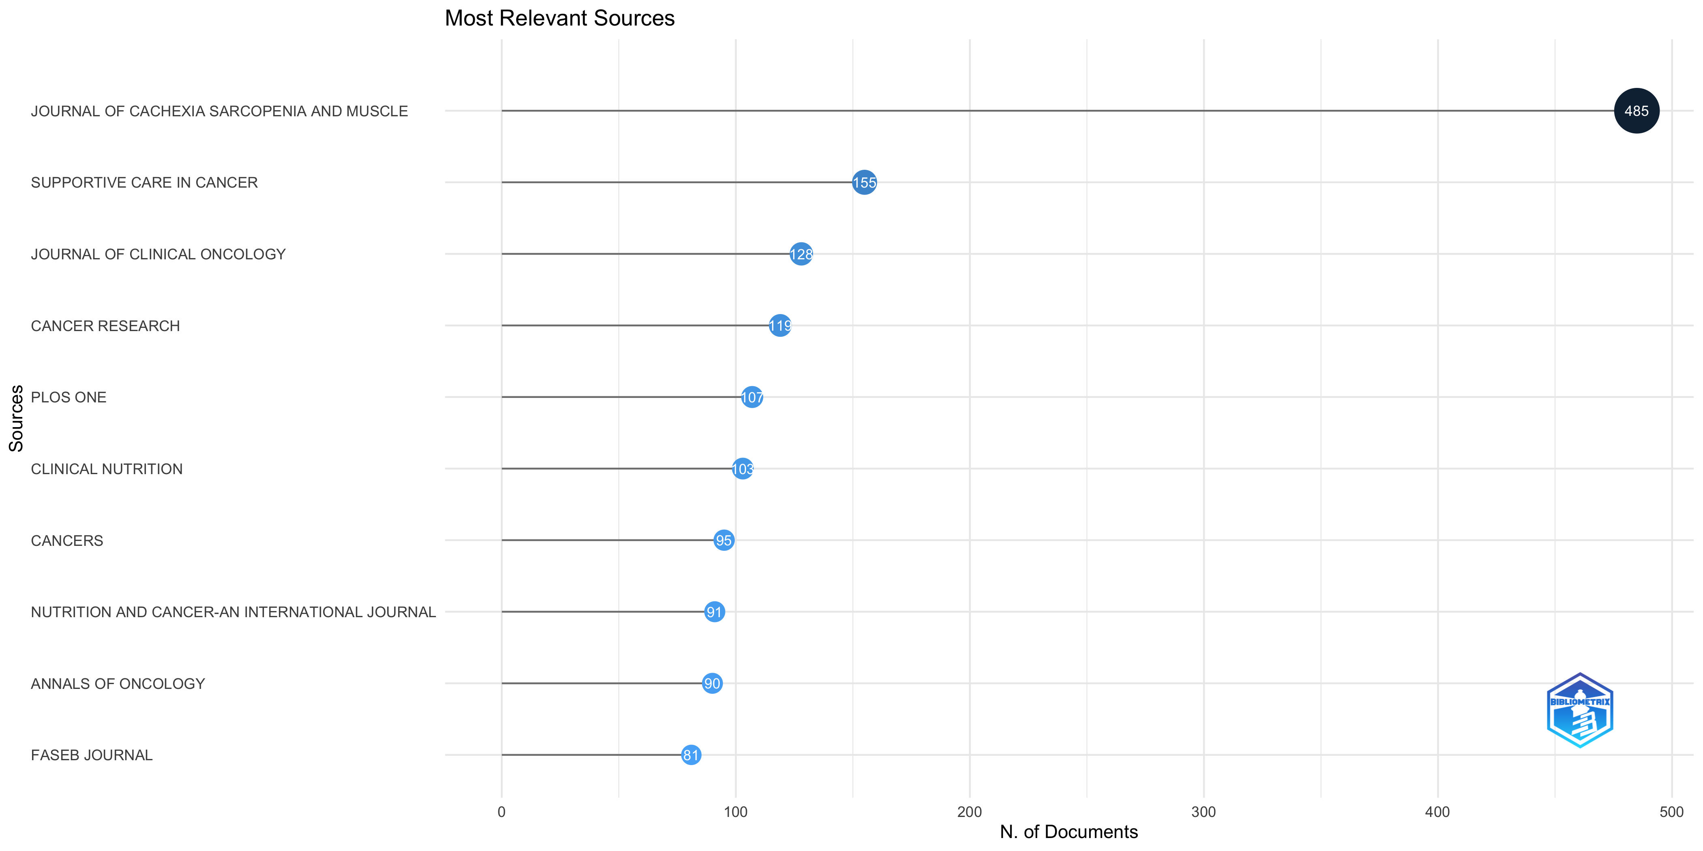
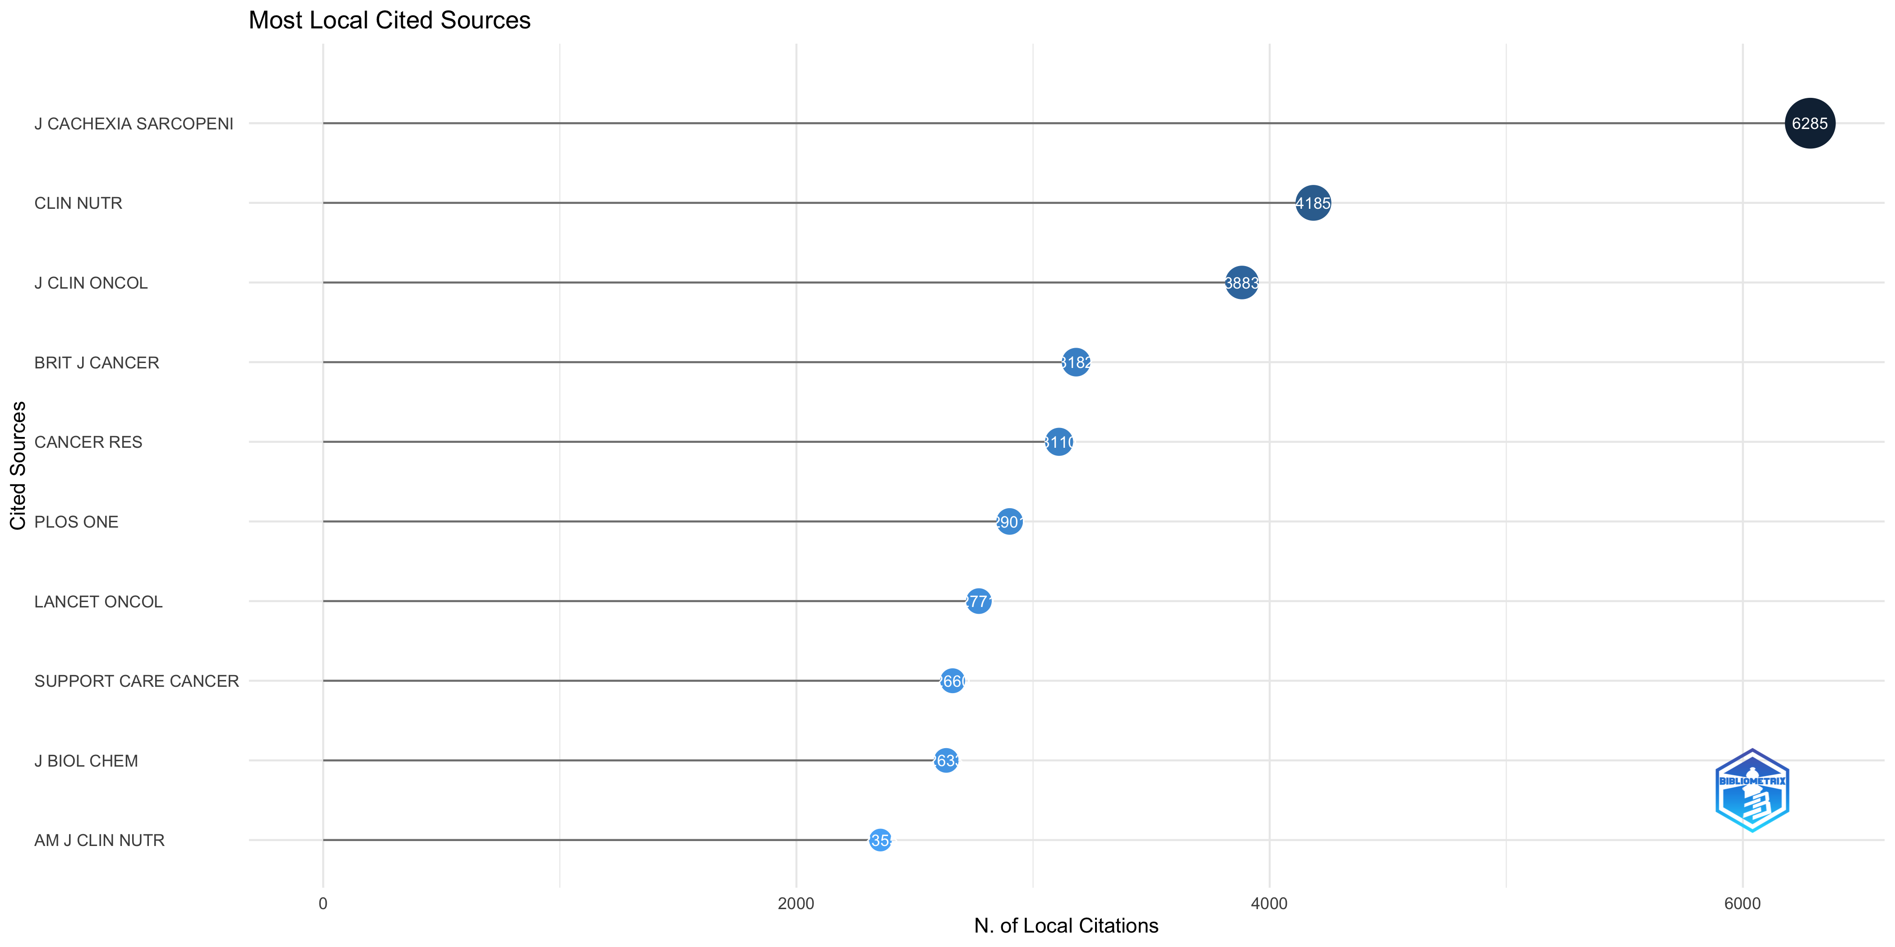
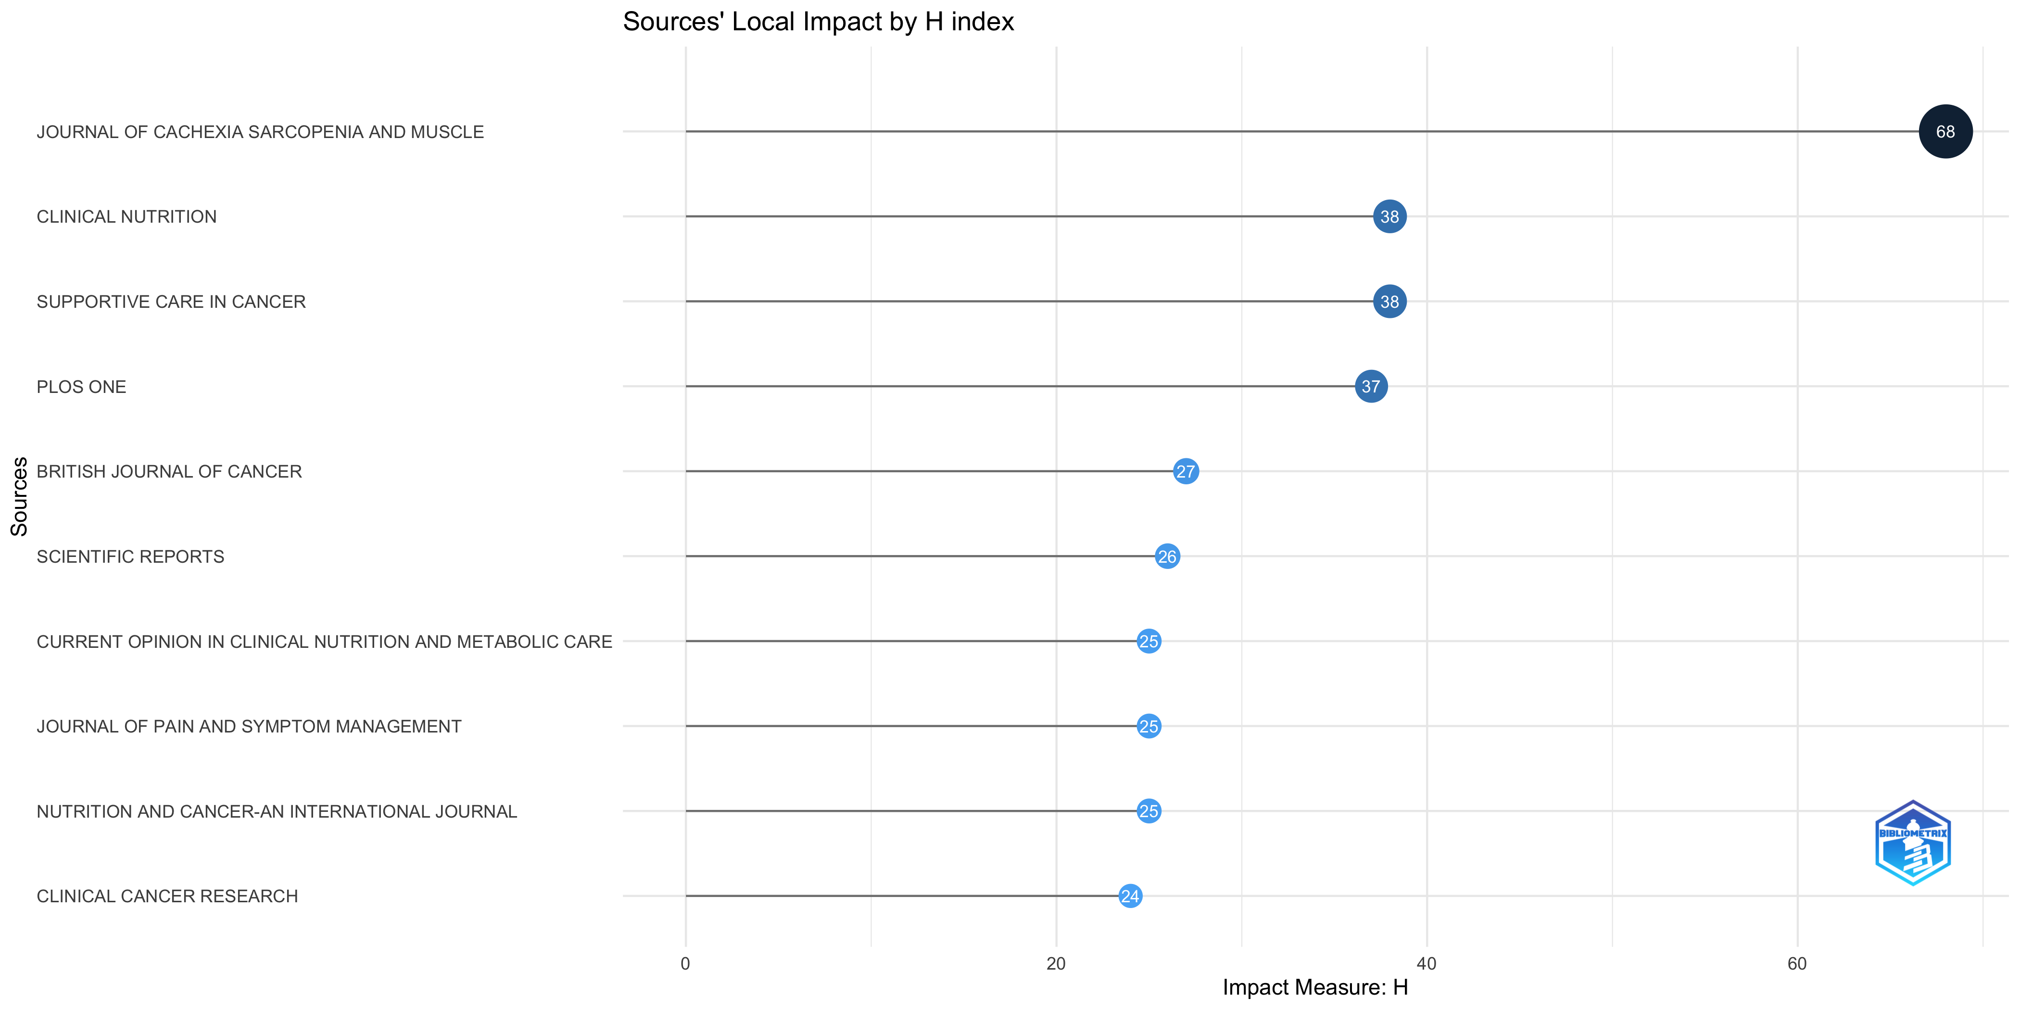
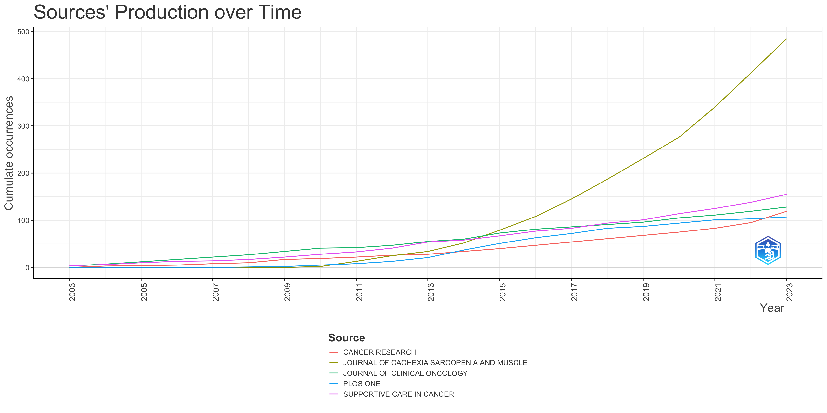
Most Relevant Sources
Most Local Cited Sources
Sources' Local Impact
Sources' Production over Time

Slide 10
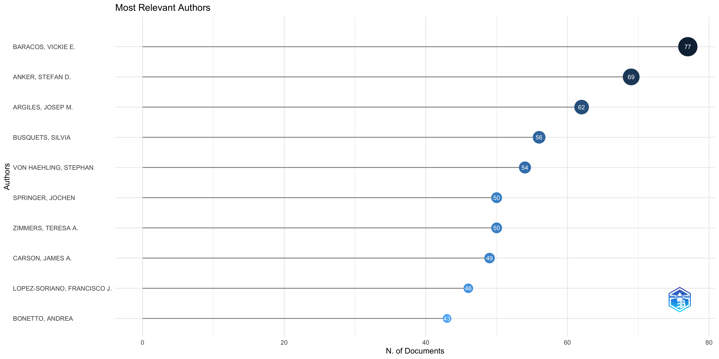
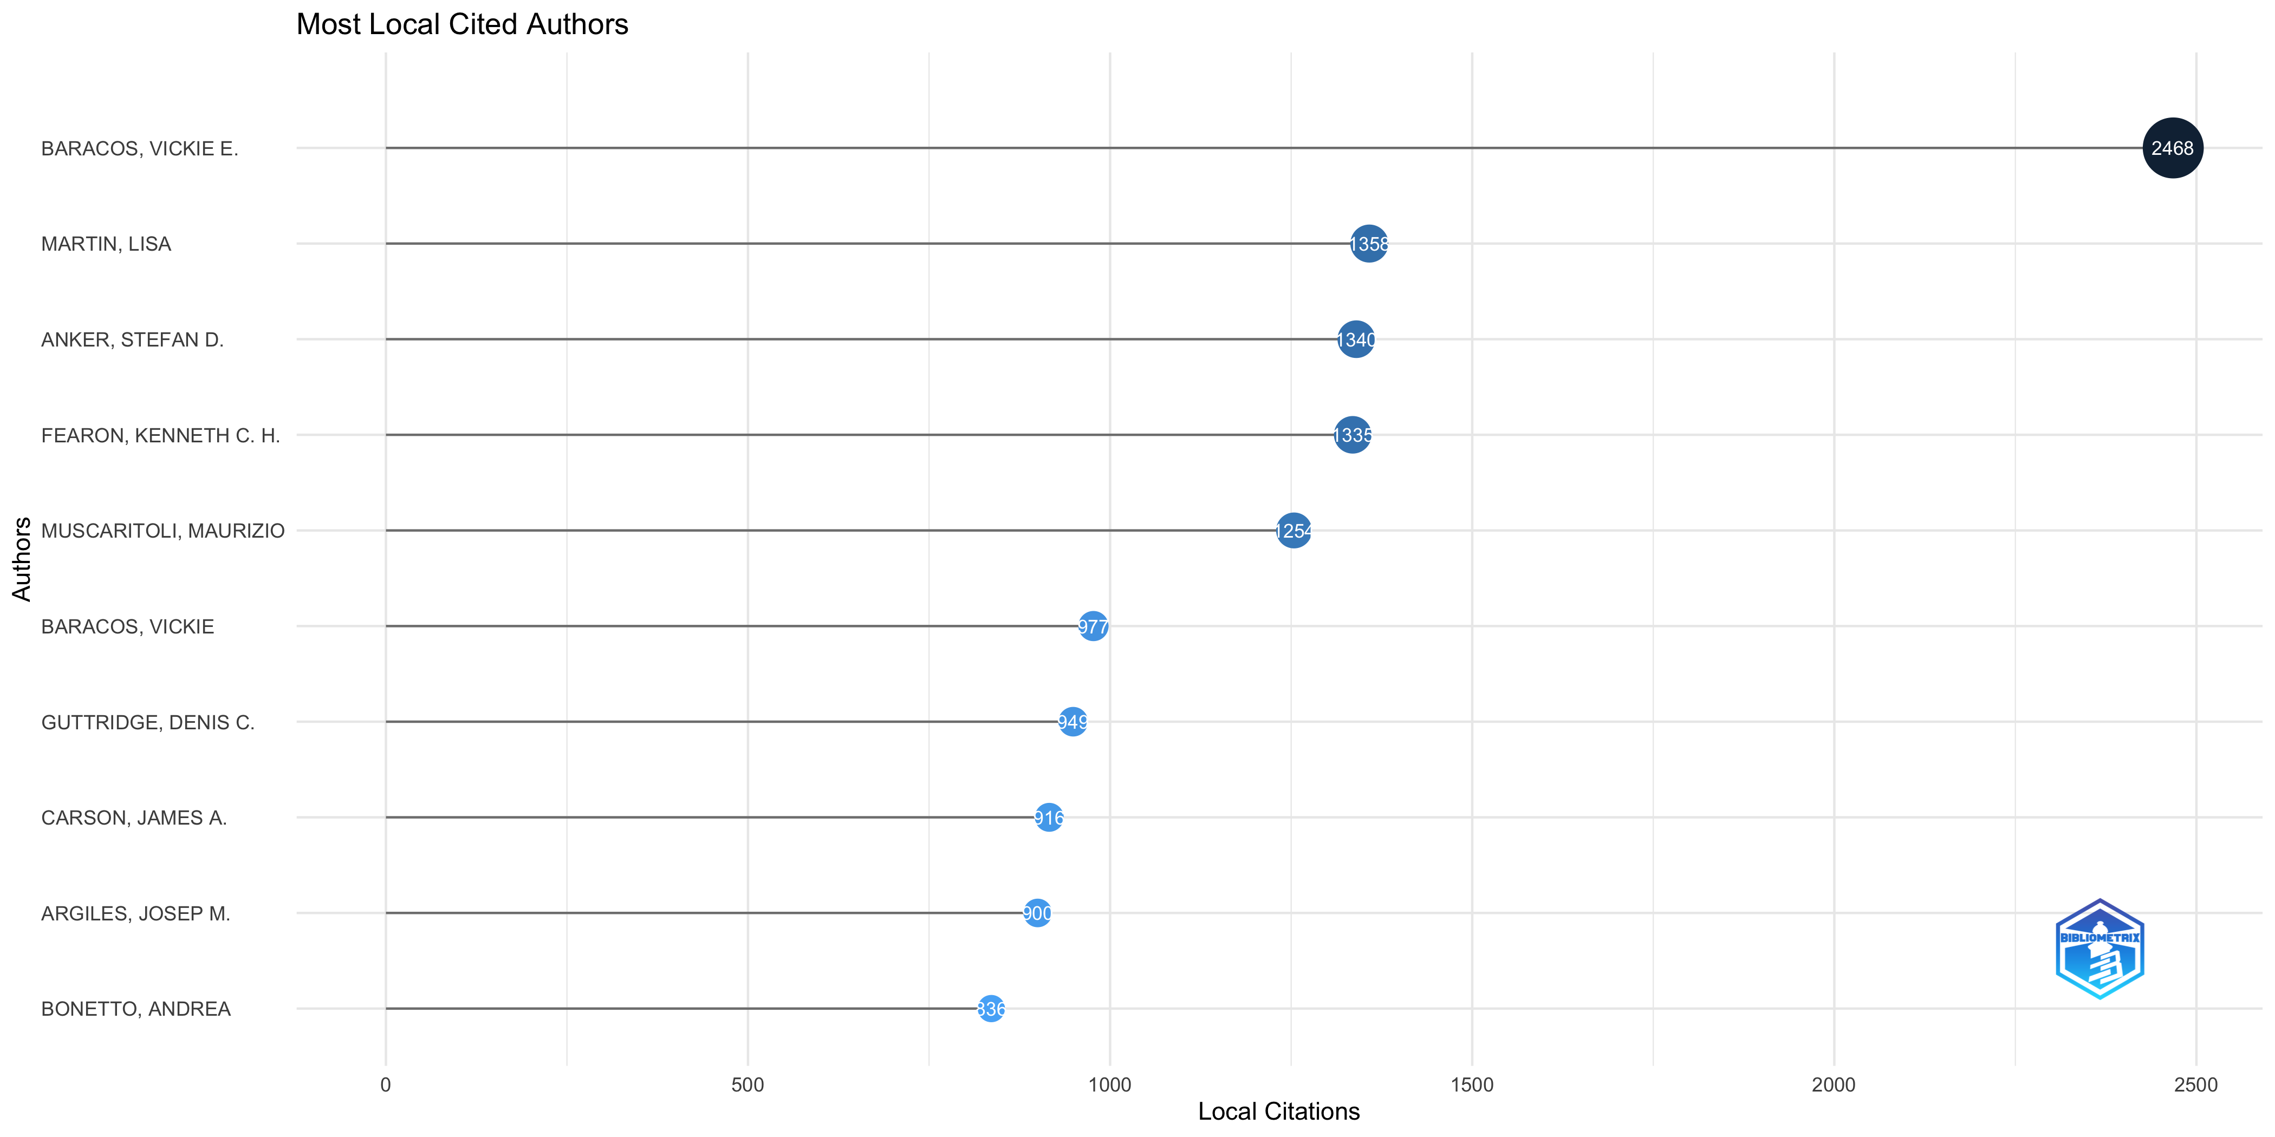
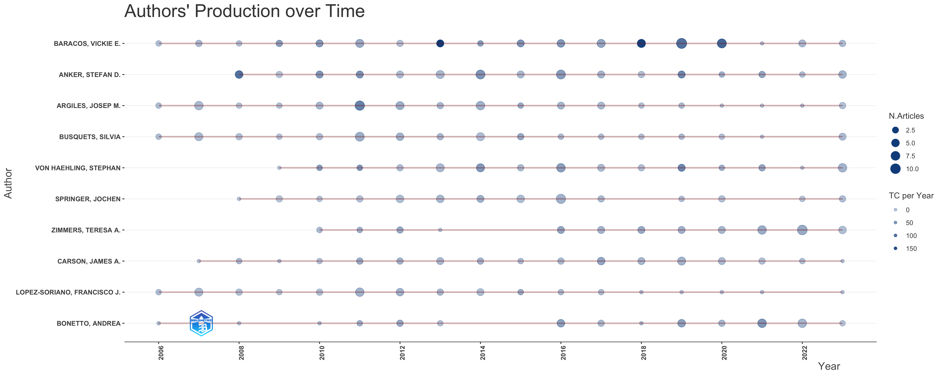
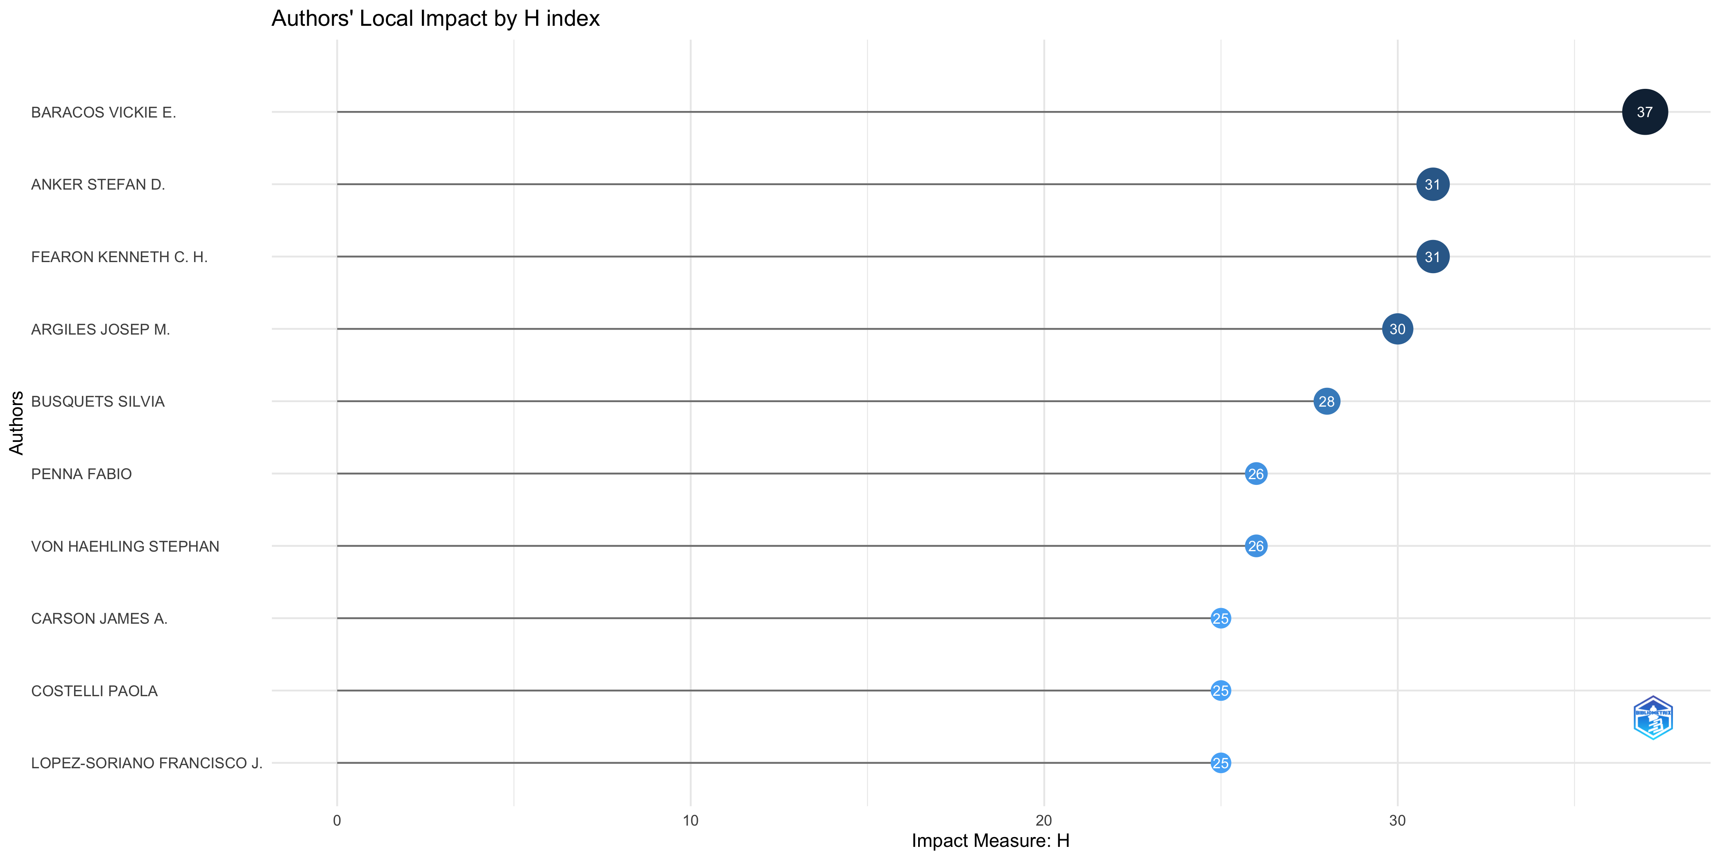
Most Relevant Authors
Most Local Cited Authors
Authors' Production over Time
Authors' Local Impact

Slide 11
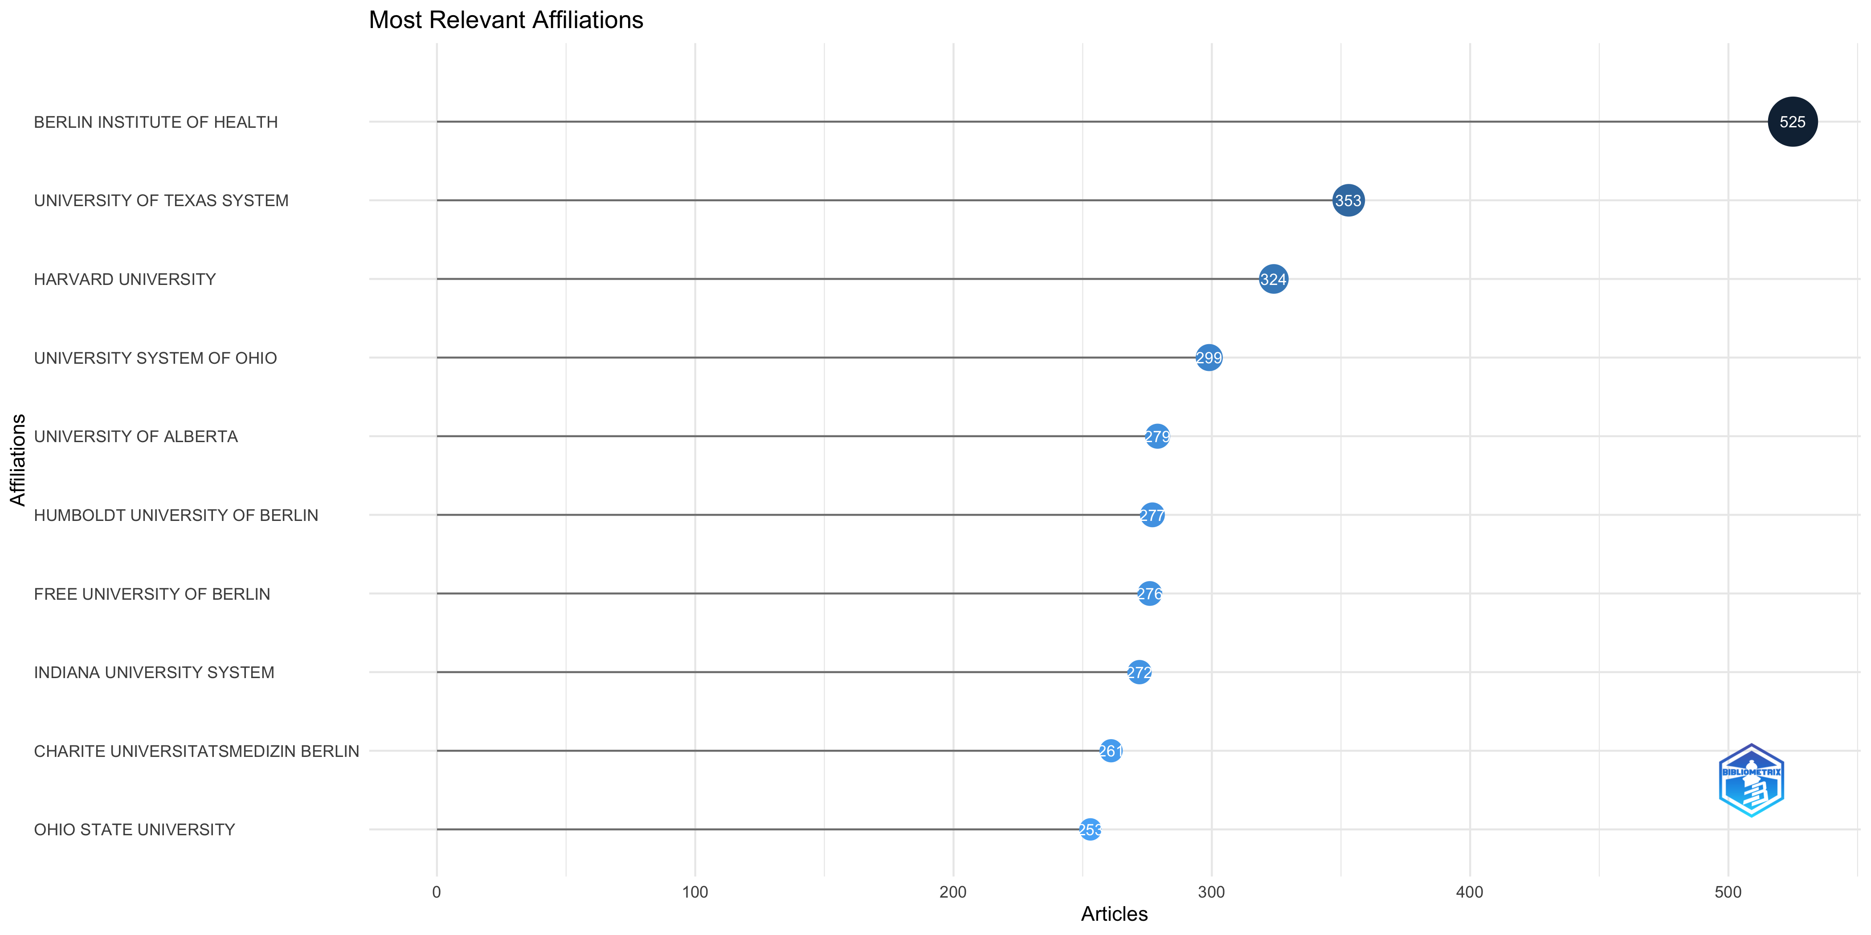
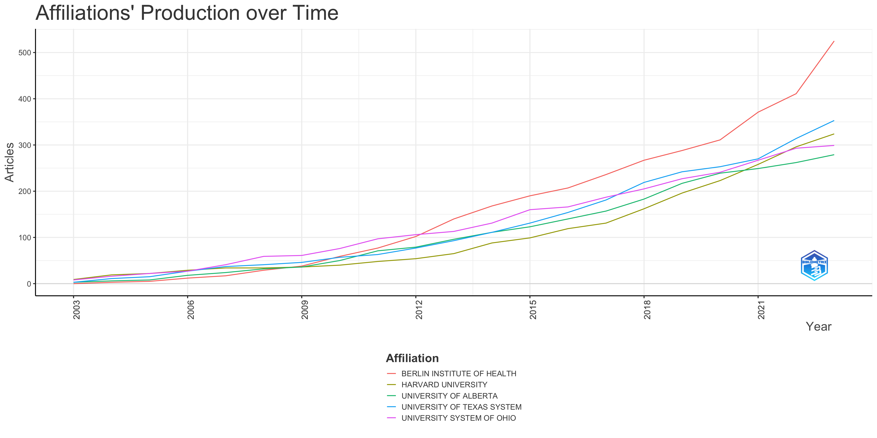
Most Relevant Affiliations
Affiliations' Production over Time

Slide 12
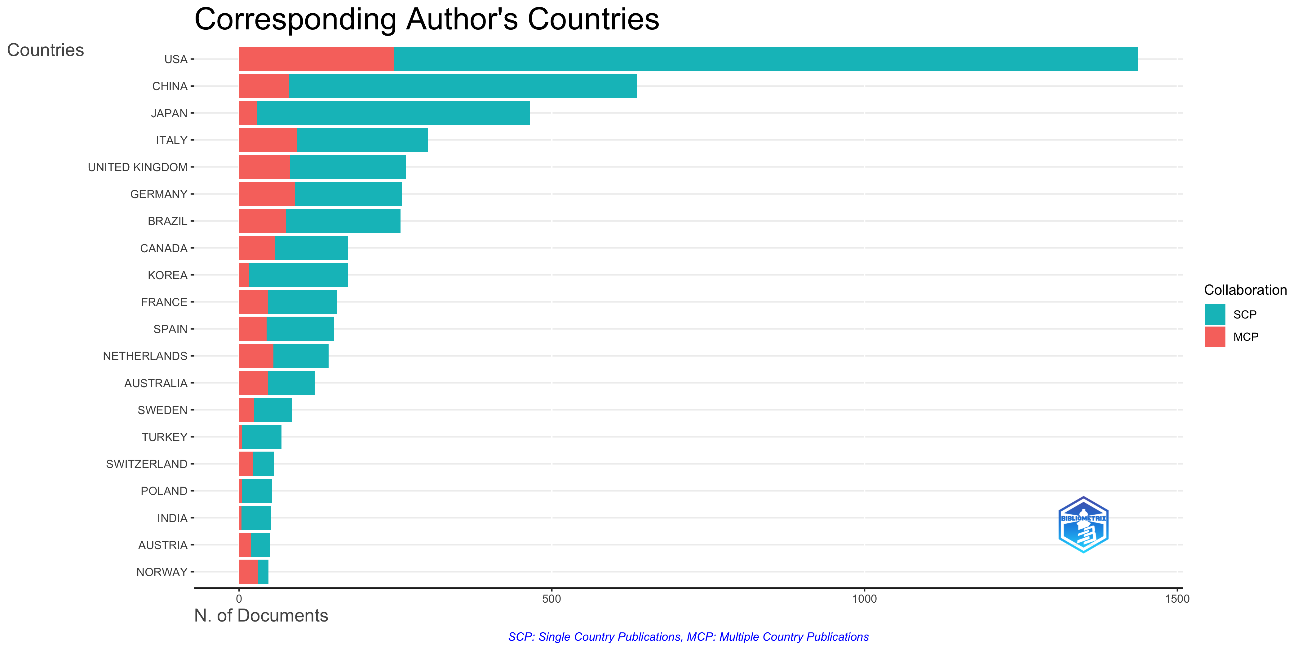
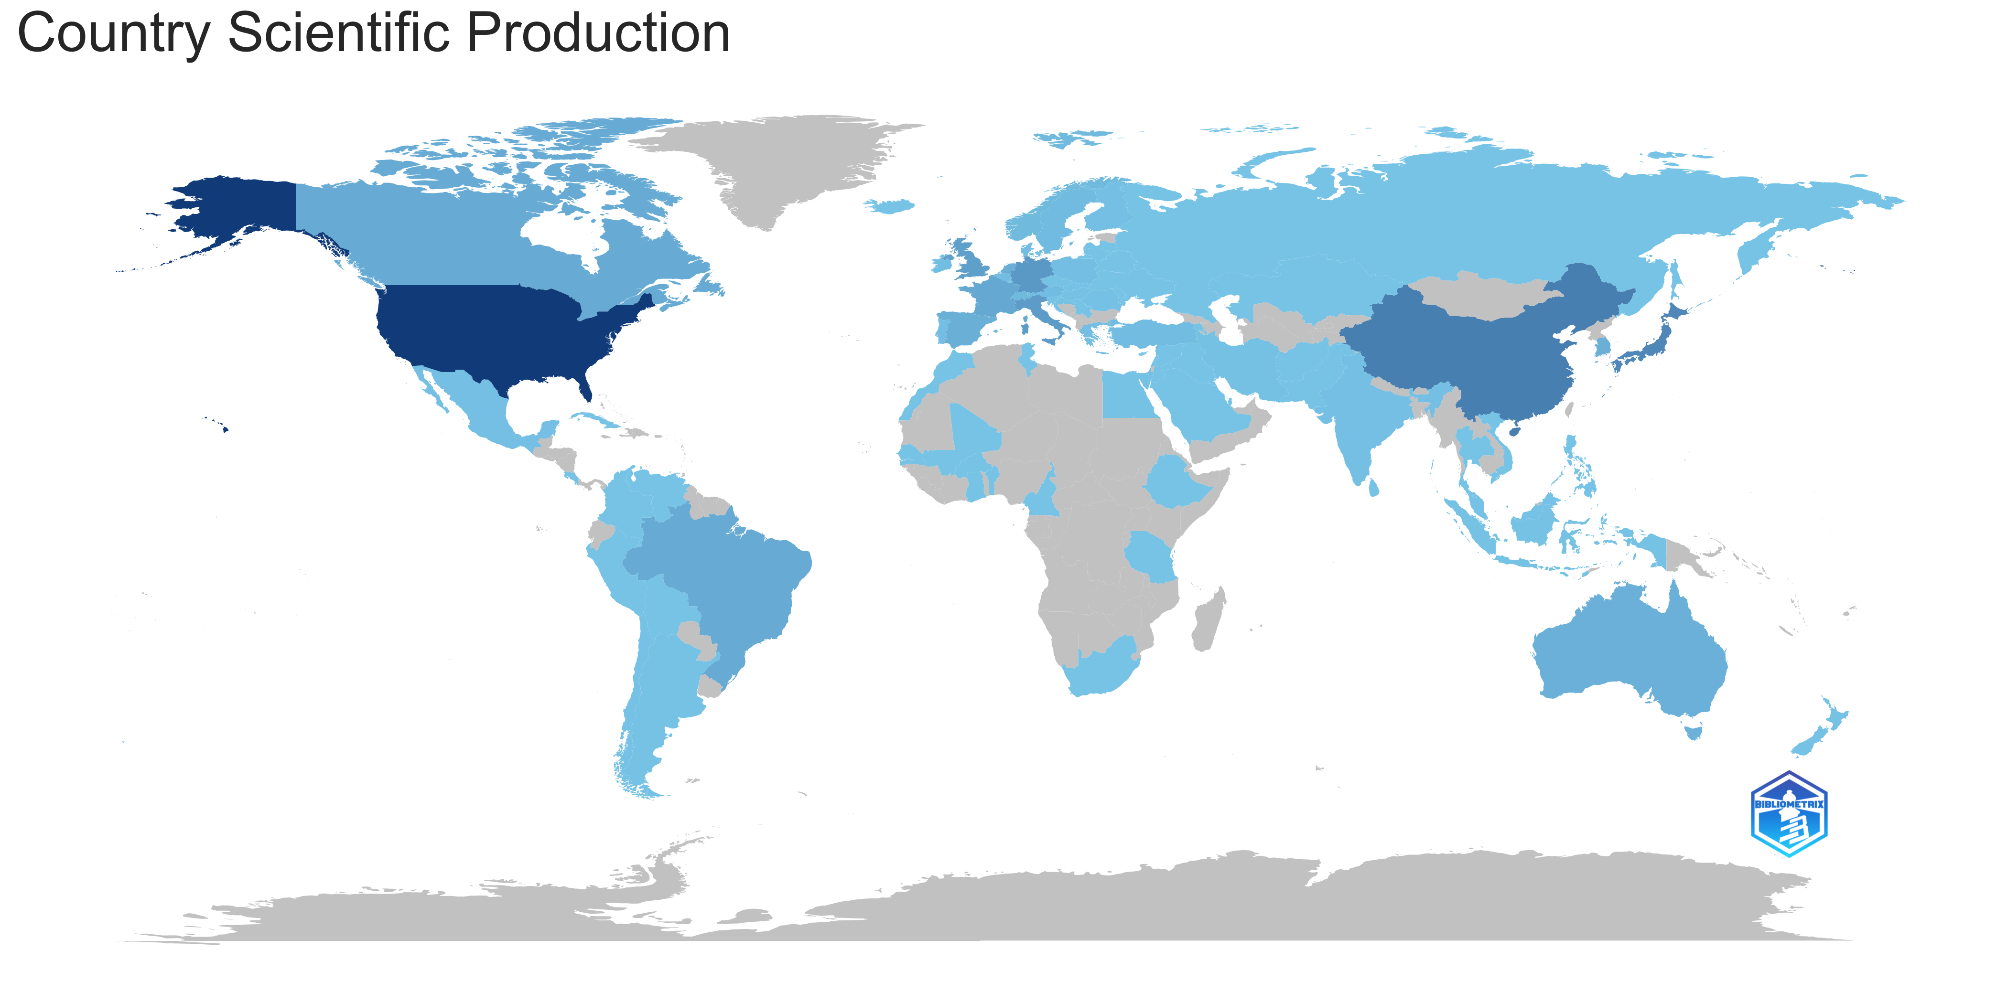
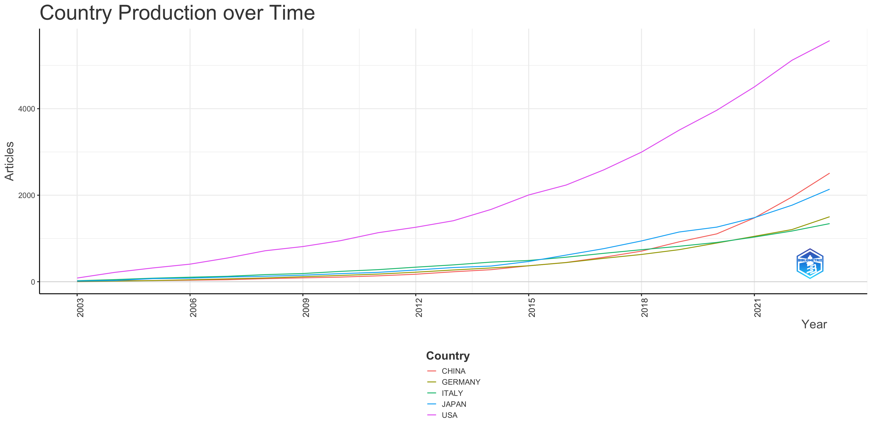
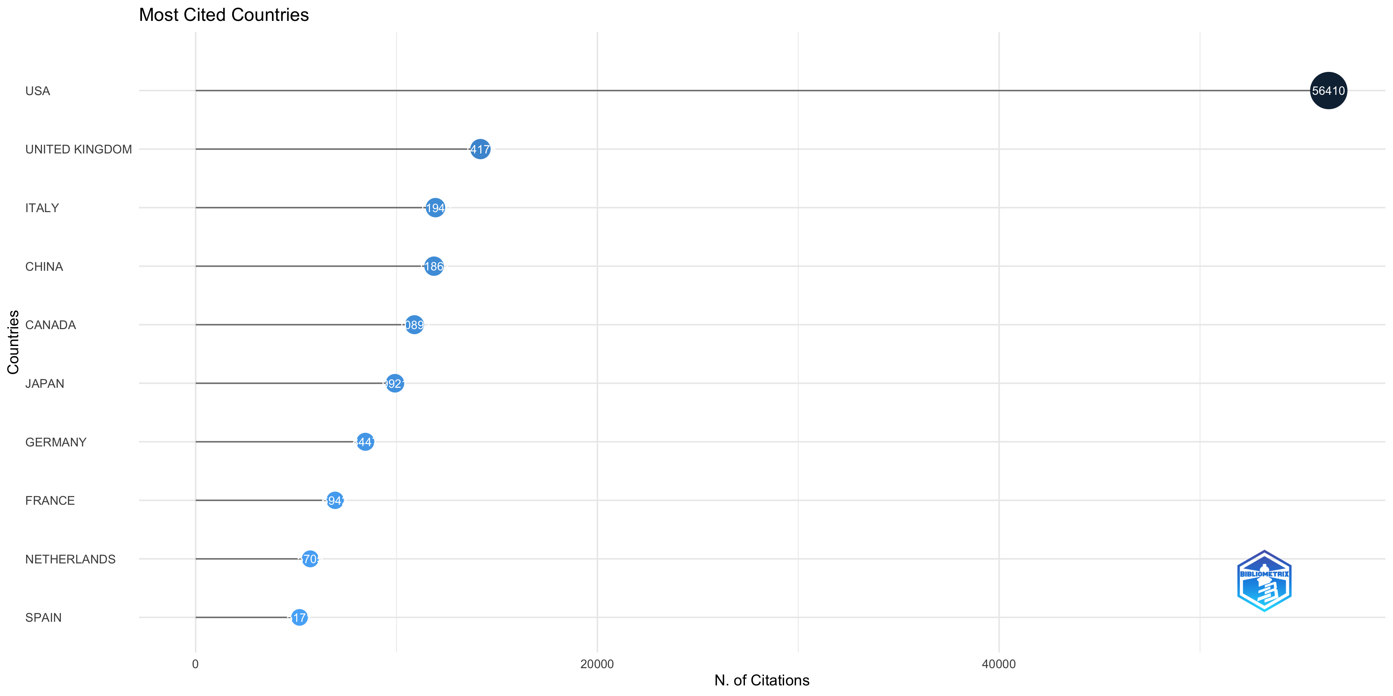
Corresponding Author's Countries
Countries' Scientific Production
Countries' Production over Time
Most Cited Countries

Slide 13
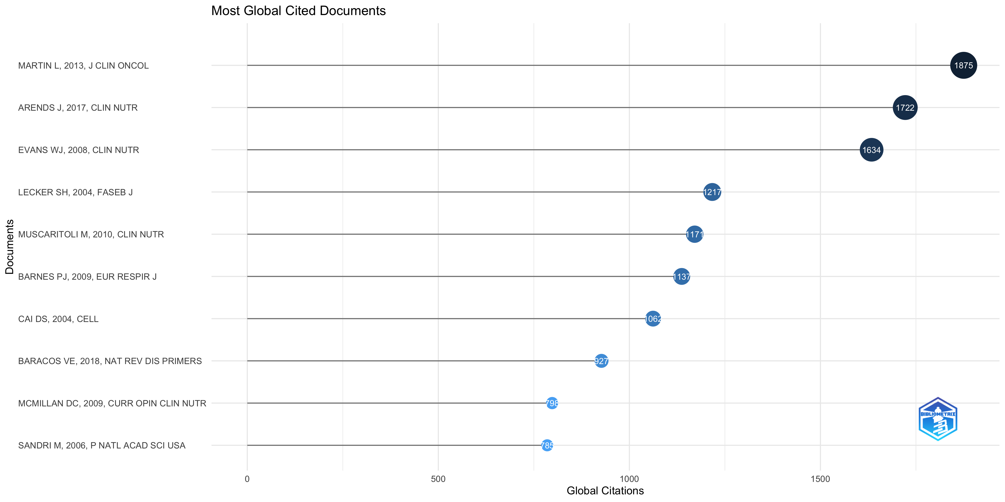
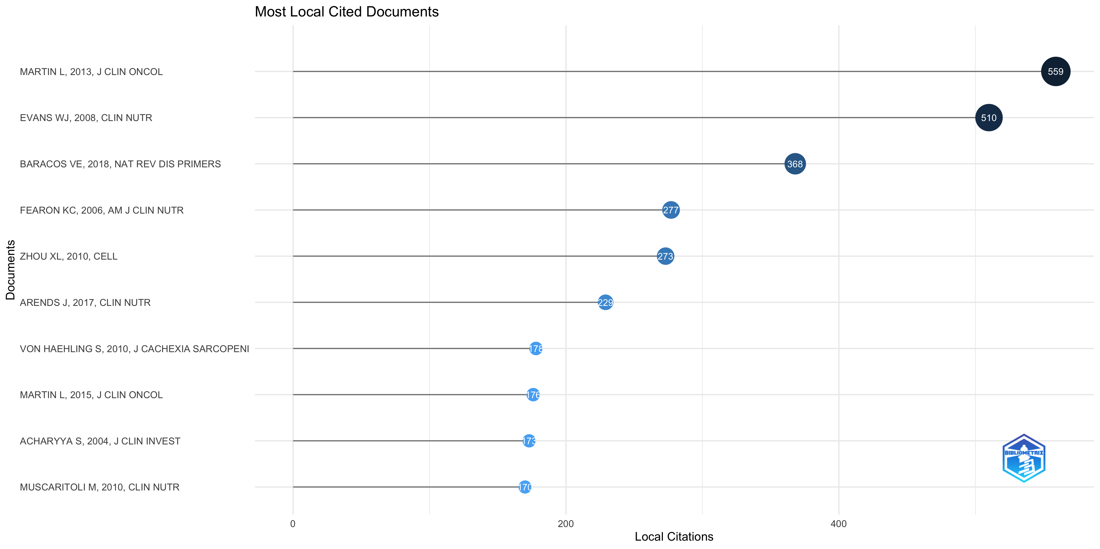
Most Global Cited Documents
Most Local Cited Documents

Slide 14
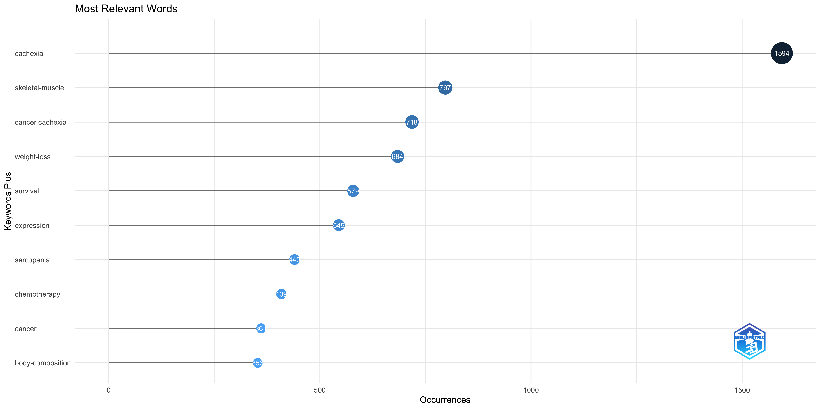
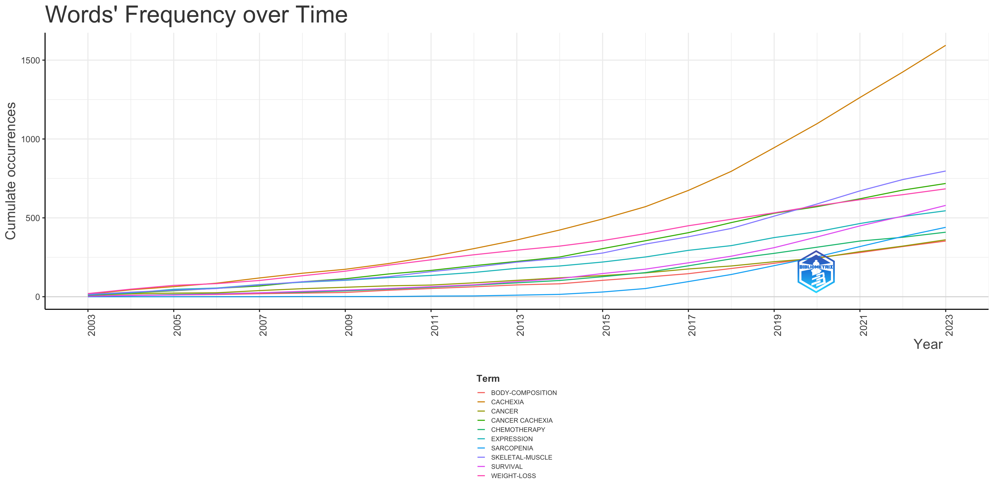
Most Frequent Words
Words' Frequency over Time

Slide 15
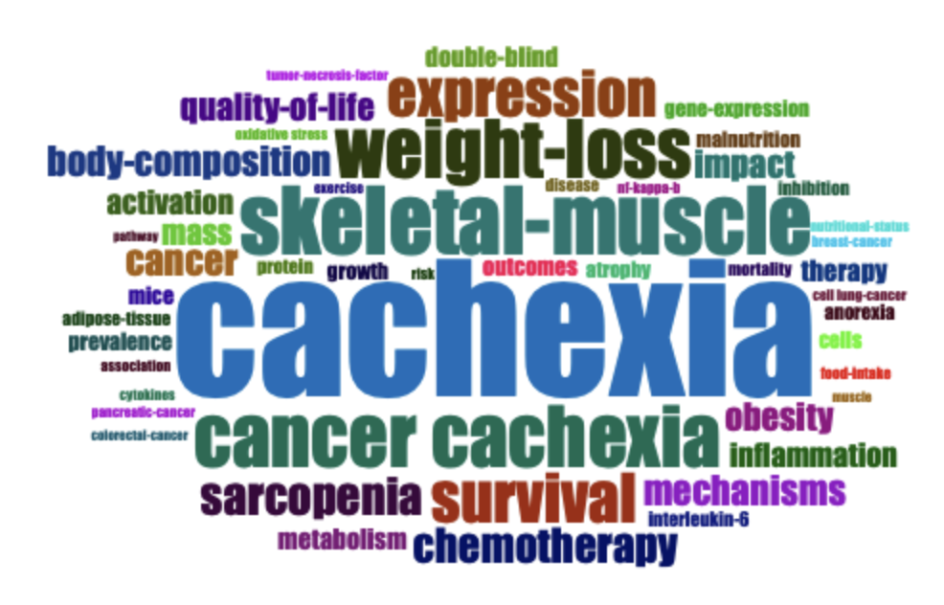
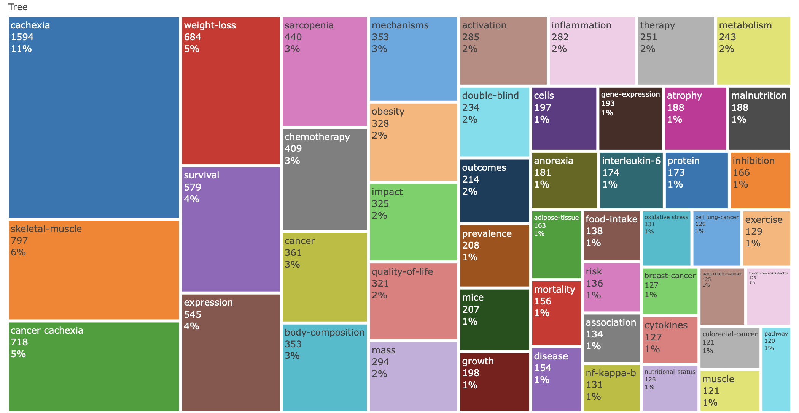
WordCloud
TreeMap

Slide 16
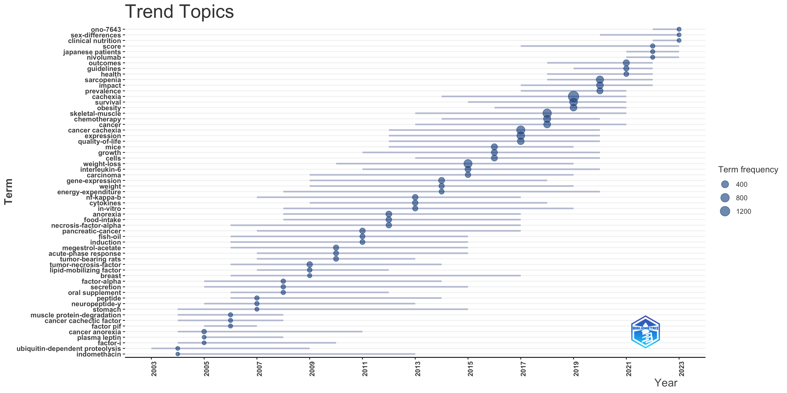

Slide 17
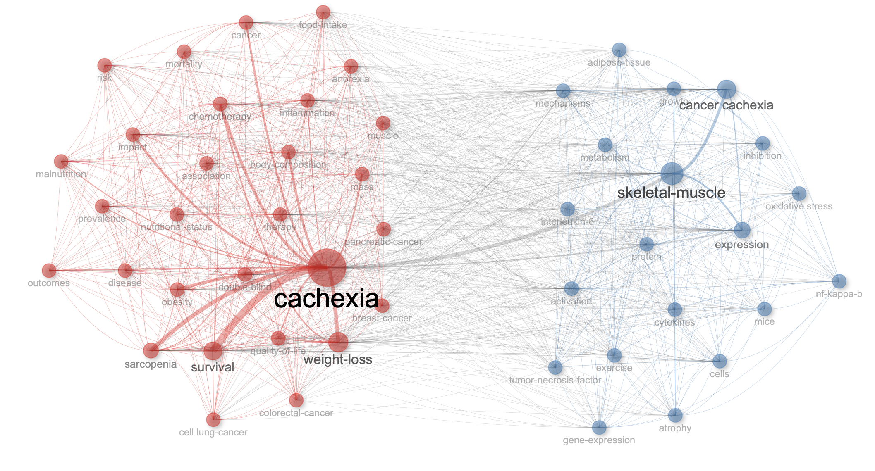
Co-occurrence Network of Keywords

Slide 18
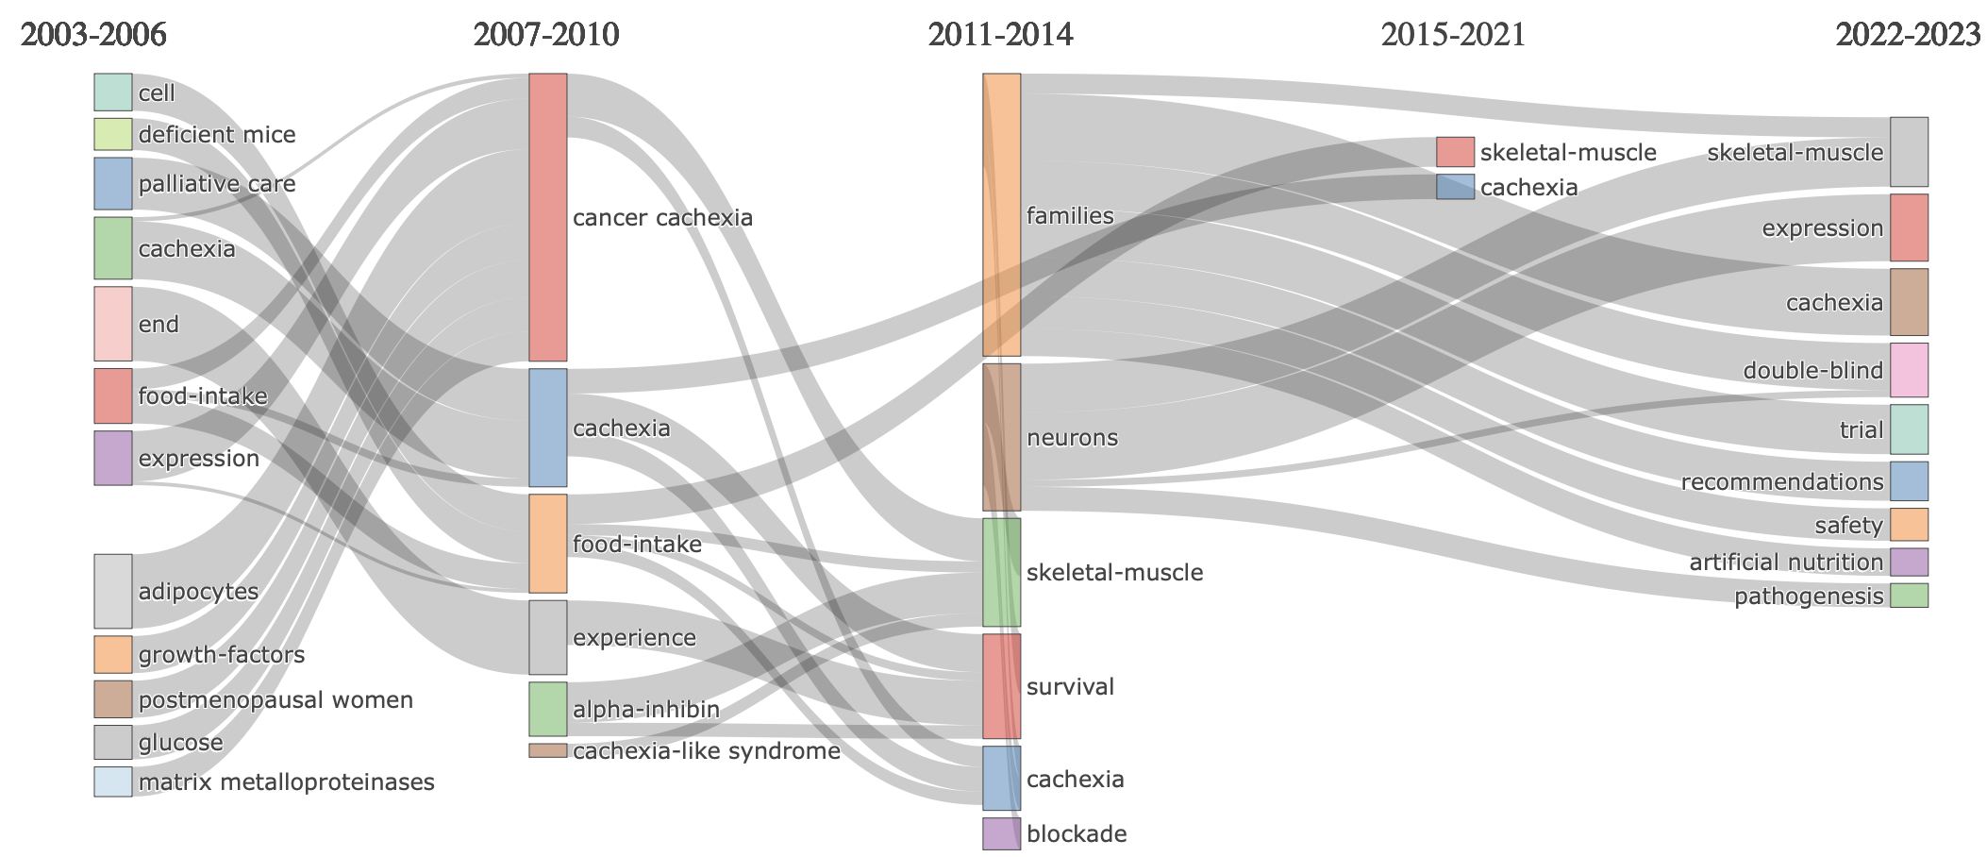
Thematic Evolution

Slide 19
Thematic Map
Thematic map categorizes research topics into four quadrants based on centrality (importance) and density (development):
Motor Themes (High centrality, high density): Core, well-developed topics driving the field.
Niche Themes (Low centrality, high density): Specialized, focused topics with less broad relevance.
Emerging/Declining Themes (Low centrality, low density): Weakly developed, either gaining or losing attention.
Basic Themes (High centrality, low density): Foundational topics with broad connections but less development.
This map aids in understanding a research field's structure and identifying key trends.

Slide 20
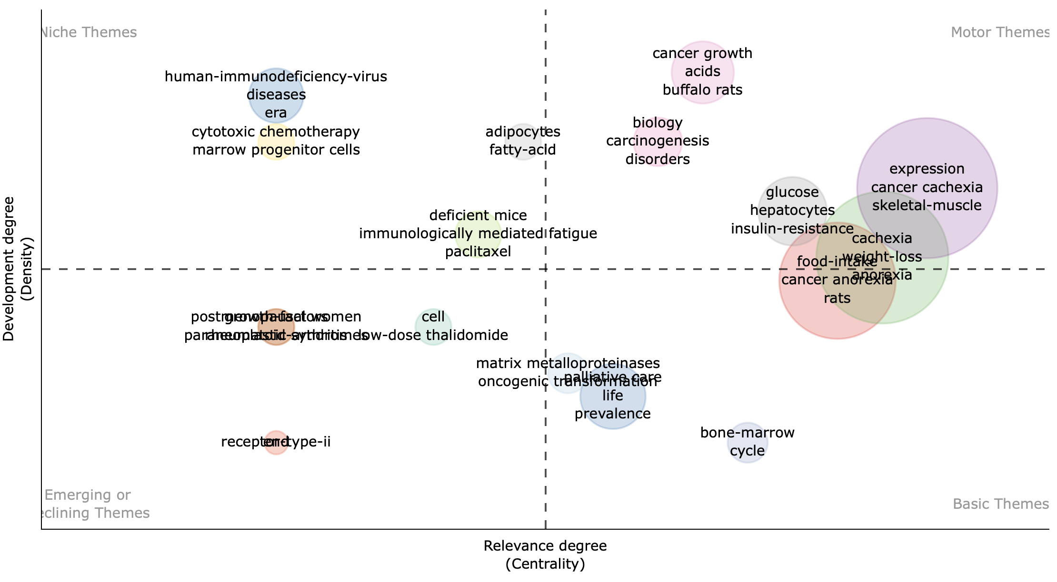
Thematic Map For Time slice 1 - 2003 to 2006

Slide 21
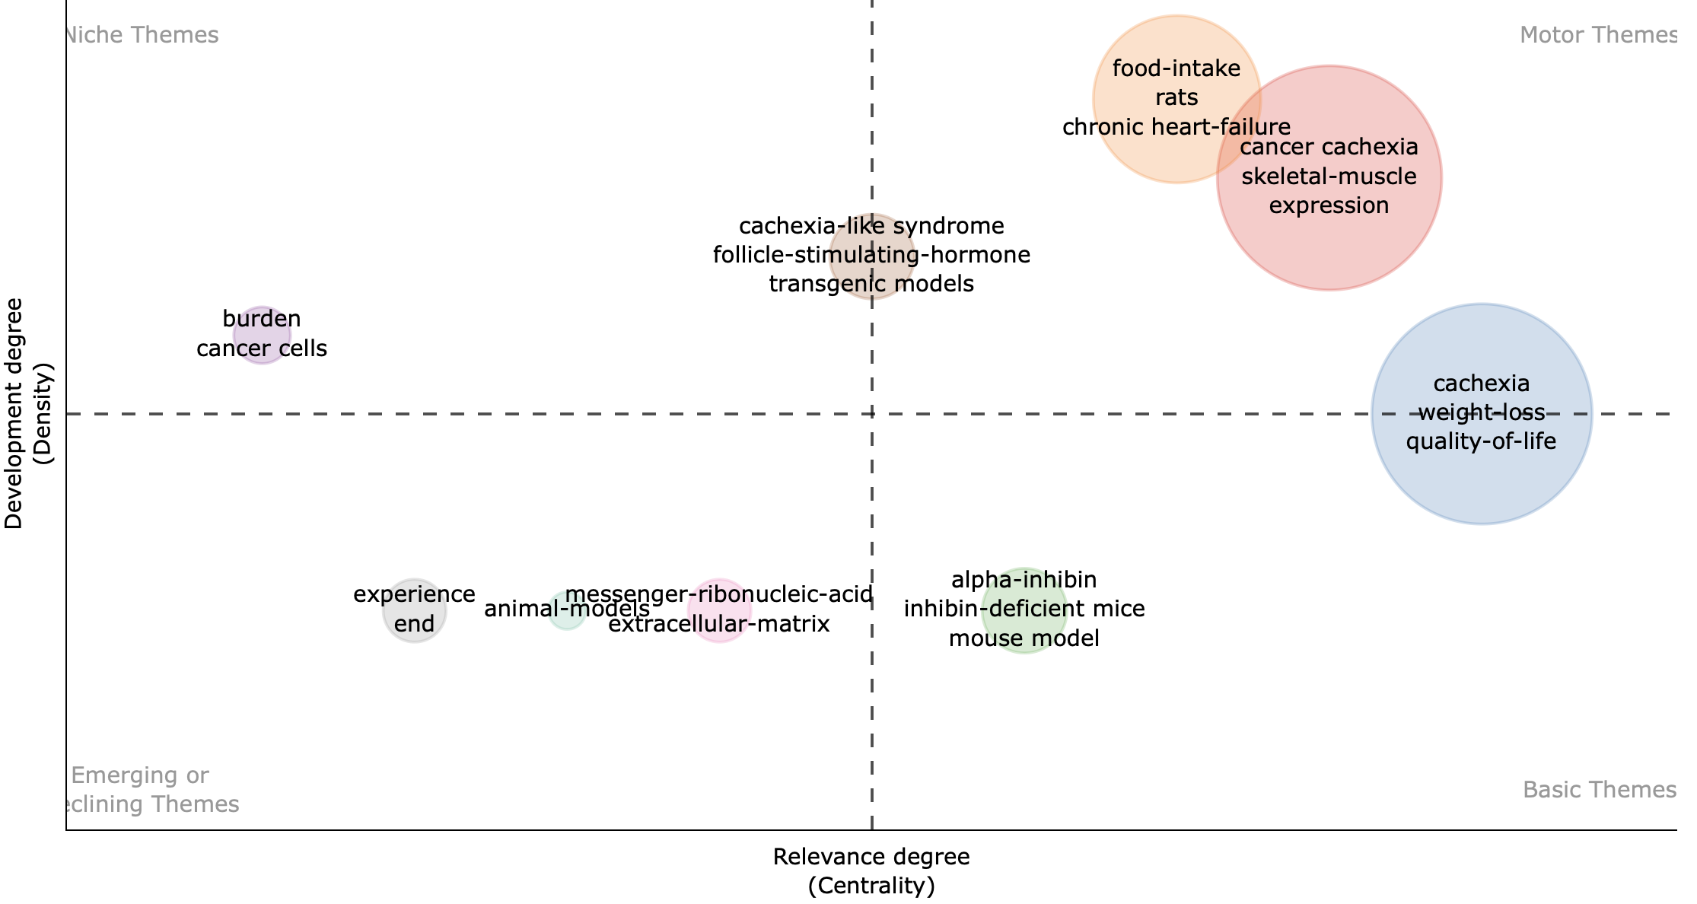
Thematic map for Time Slice 2 - 2007 to 2010

Slide 22
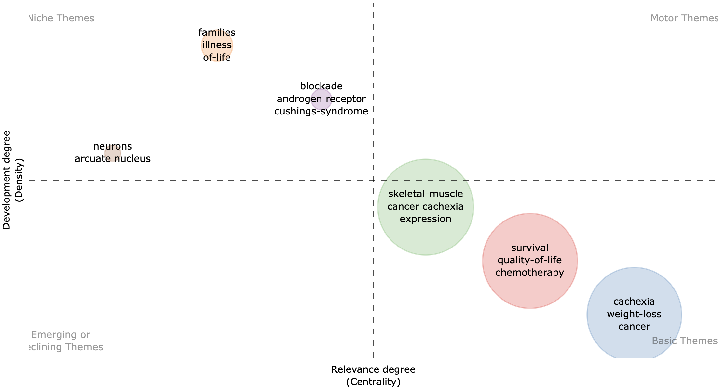
Thematic map for Time Slice 3 - 2011 to 2014

Slide 23
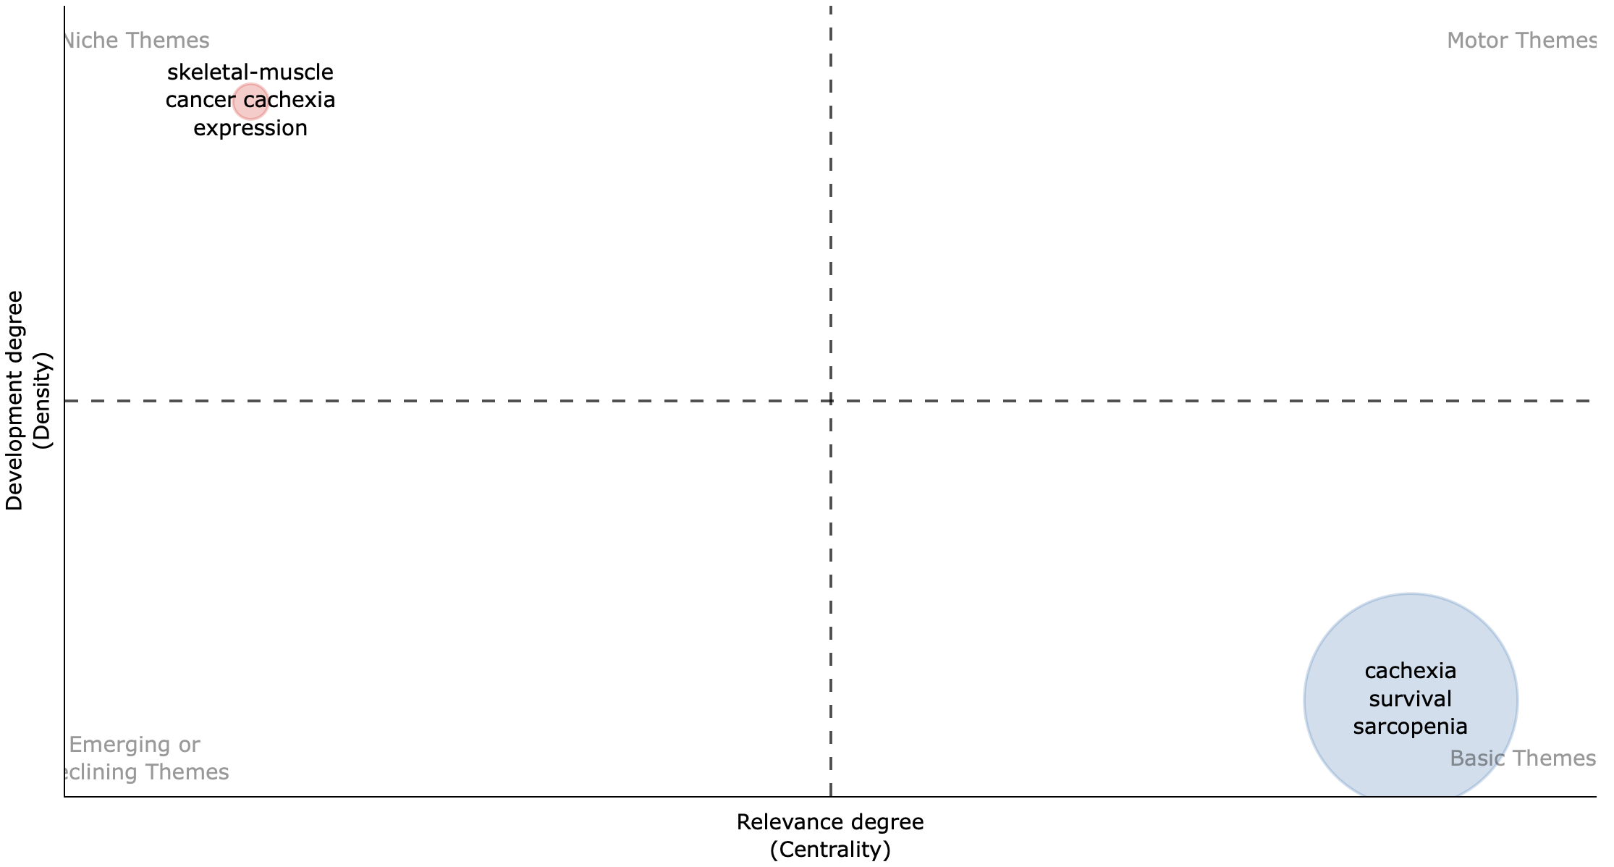
Thematic map for Time Slice 4 - 2015 to 2021

Slide 24
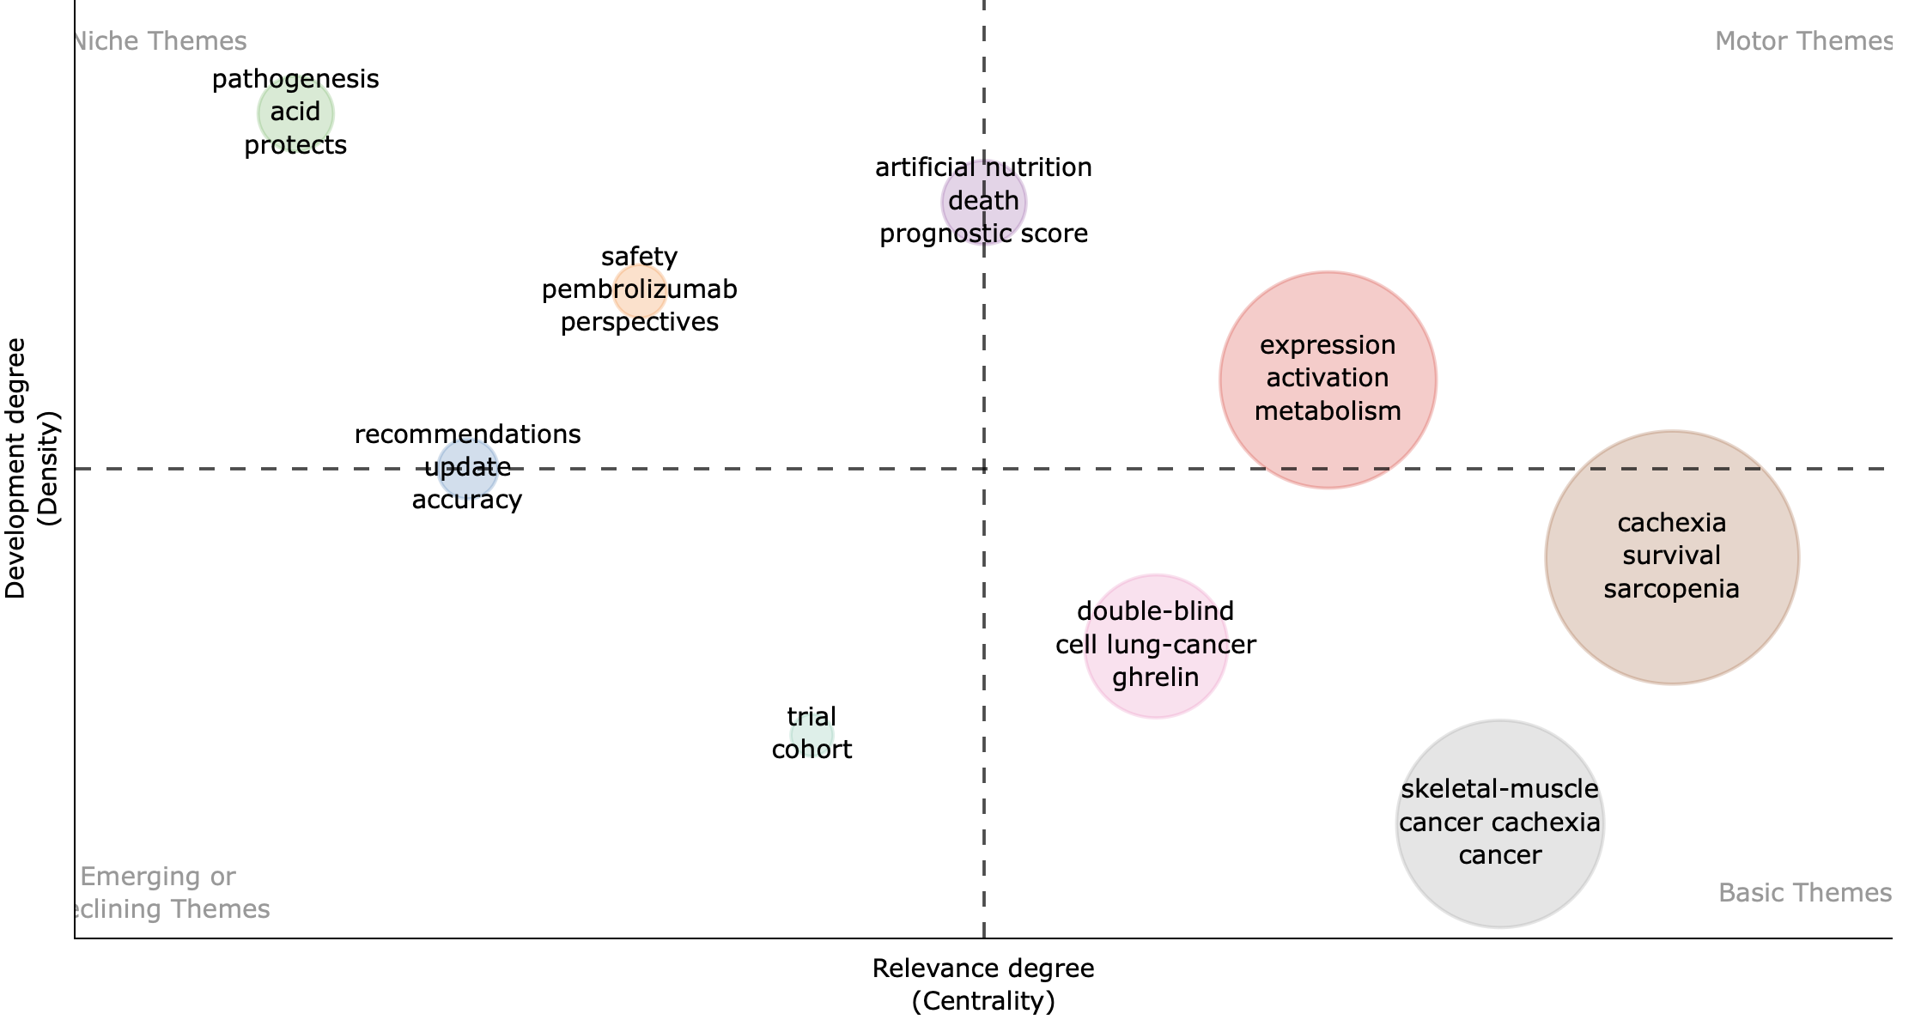
Thematic map for Time Slice – 2022 to 2023

Slide 25
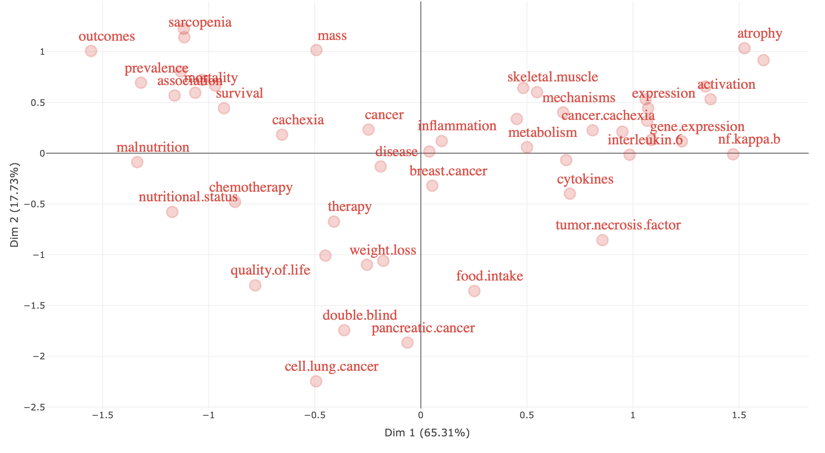
Factorial Analysis

Slide 26
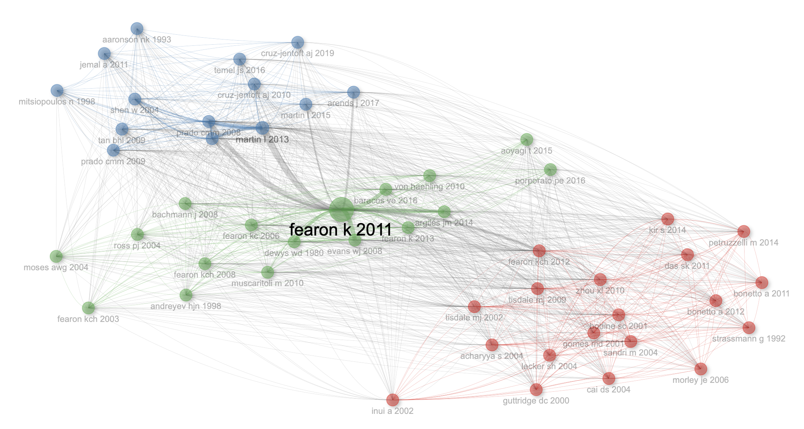
Co-citation Network of Authors

Slide 27
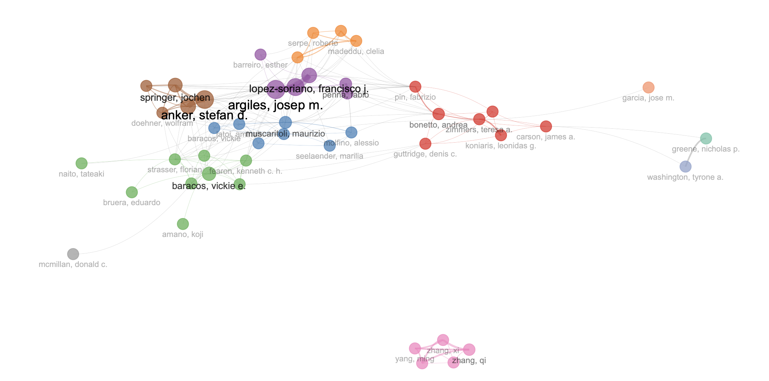
Collaboration Network of Authors

Slide 28
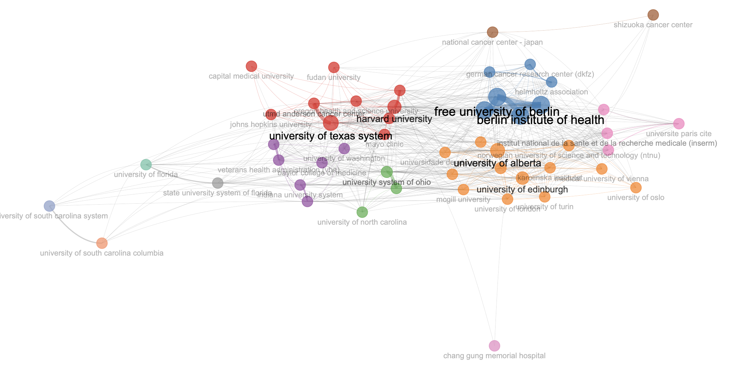
Collaboration Network of Institutions

Slide 29
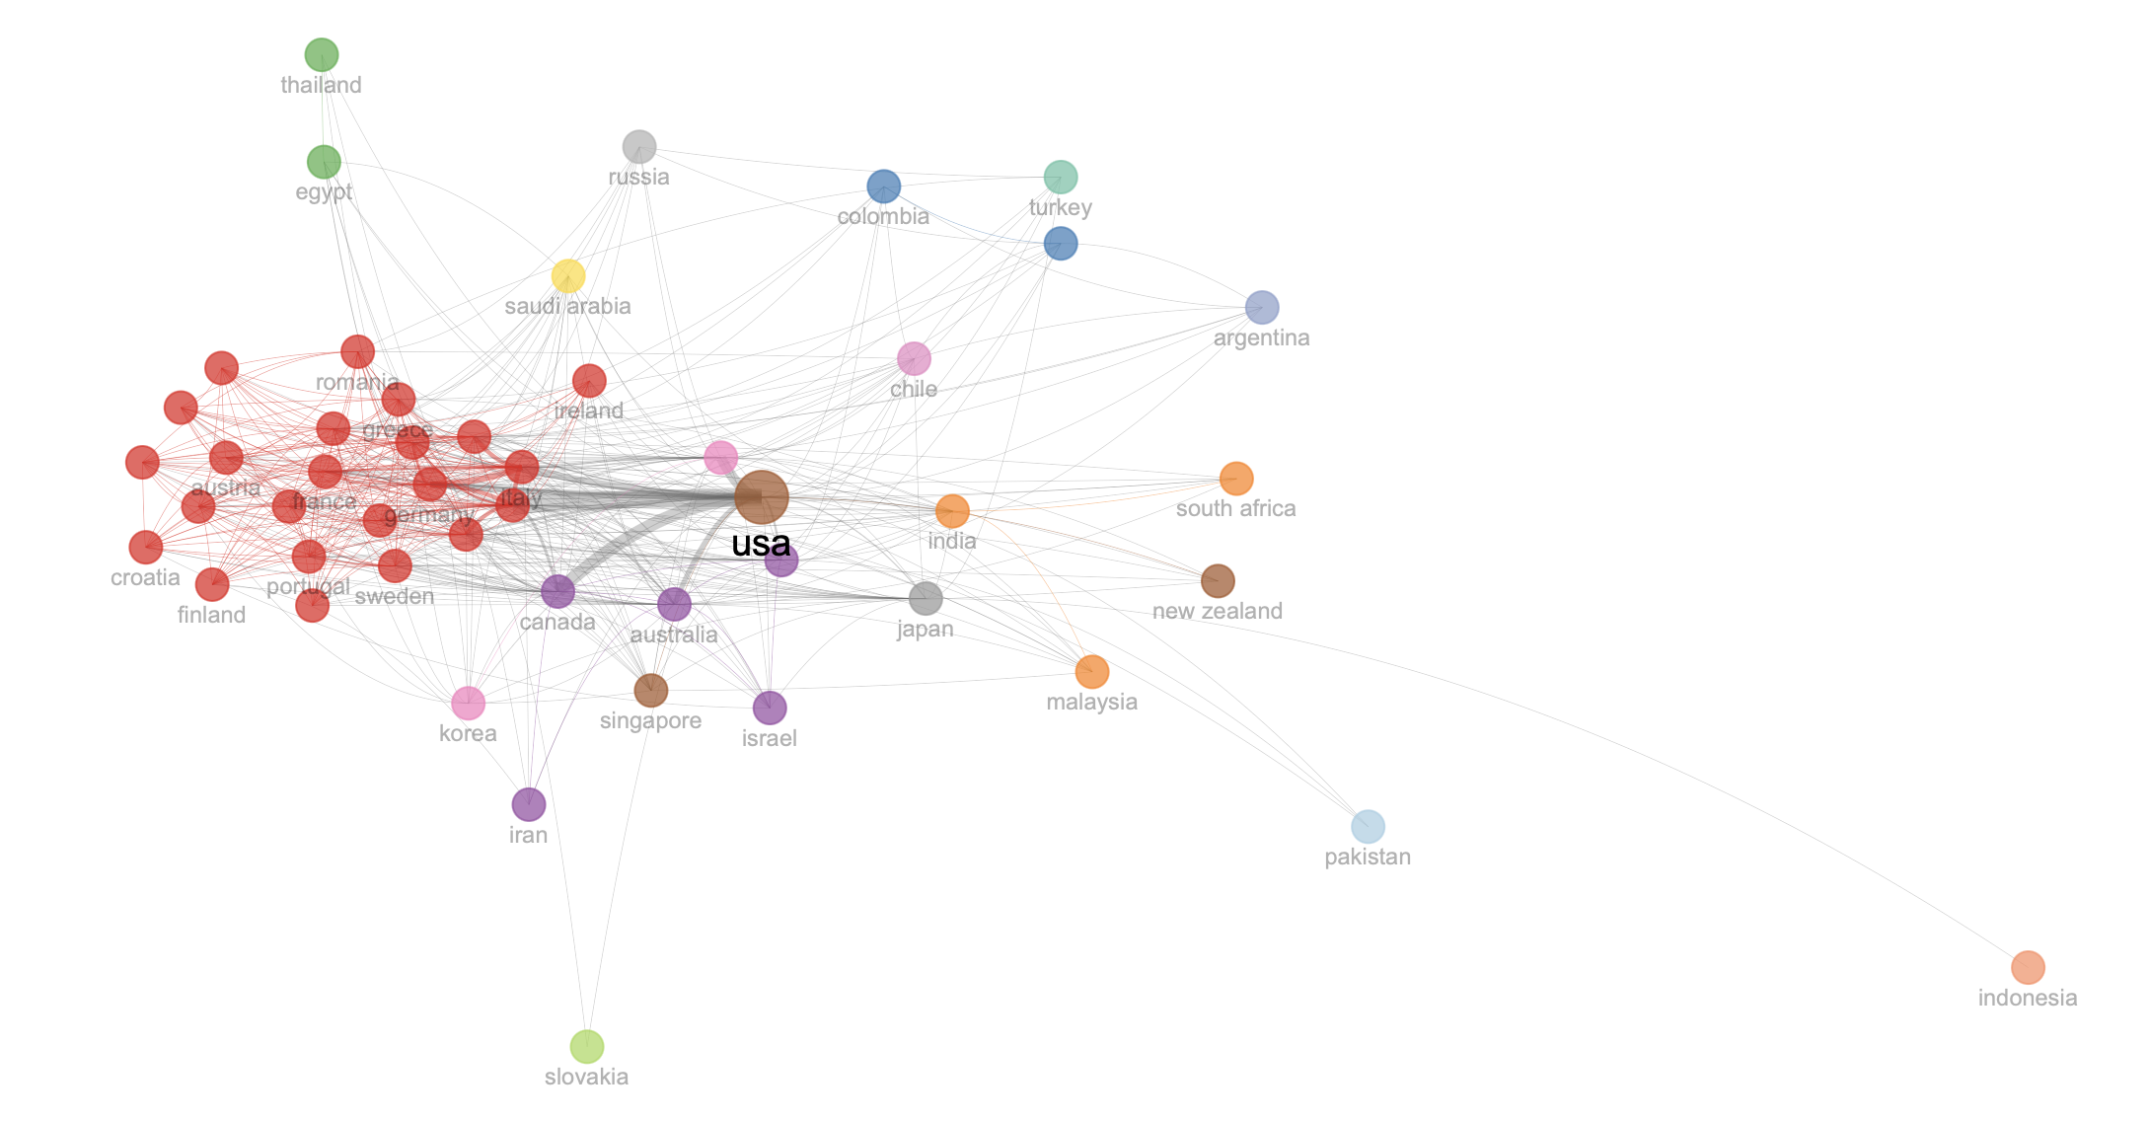
Collaboration Network of Countries

Slide 30
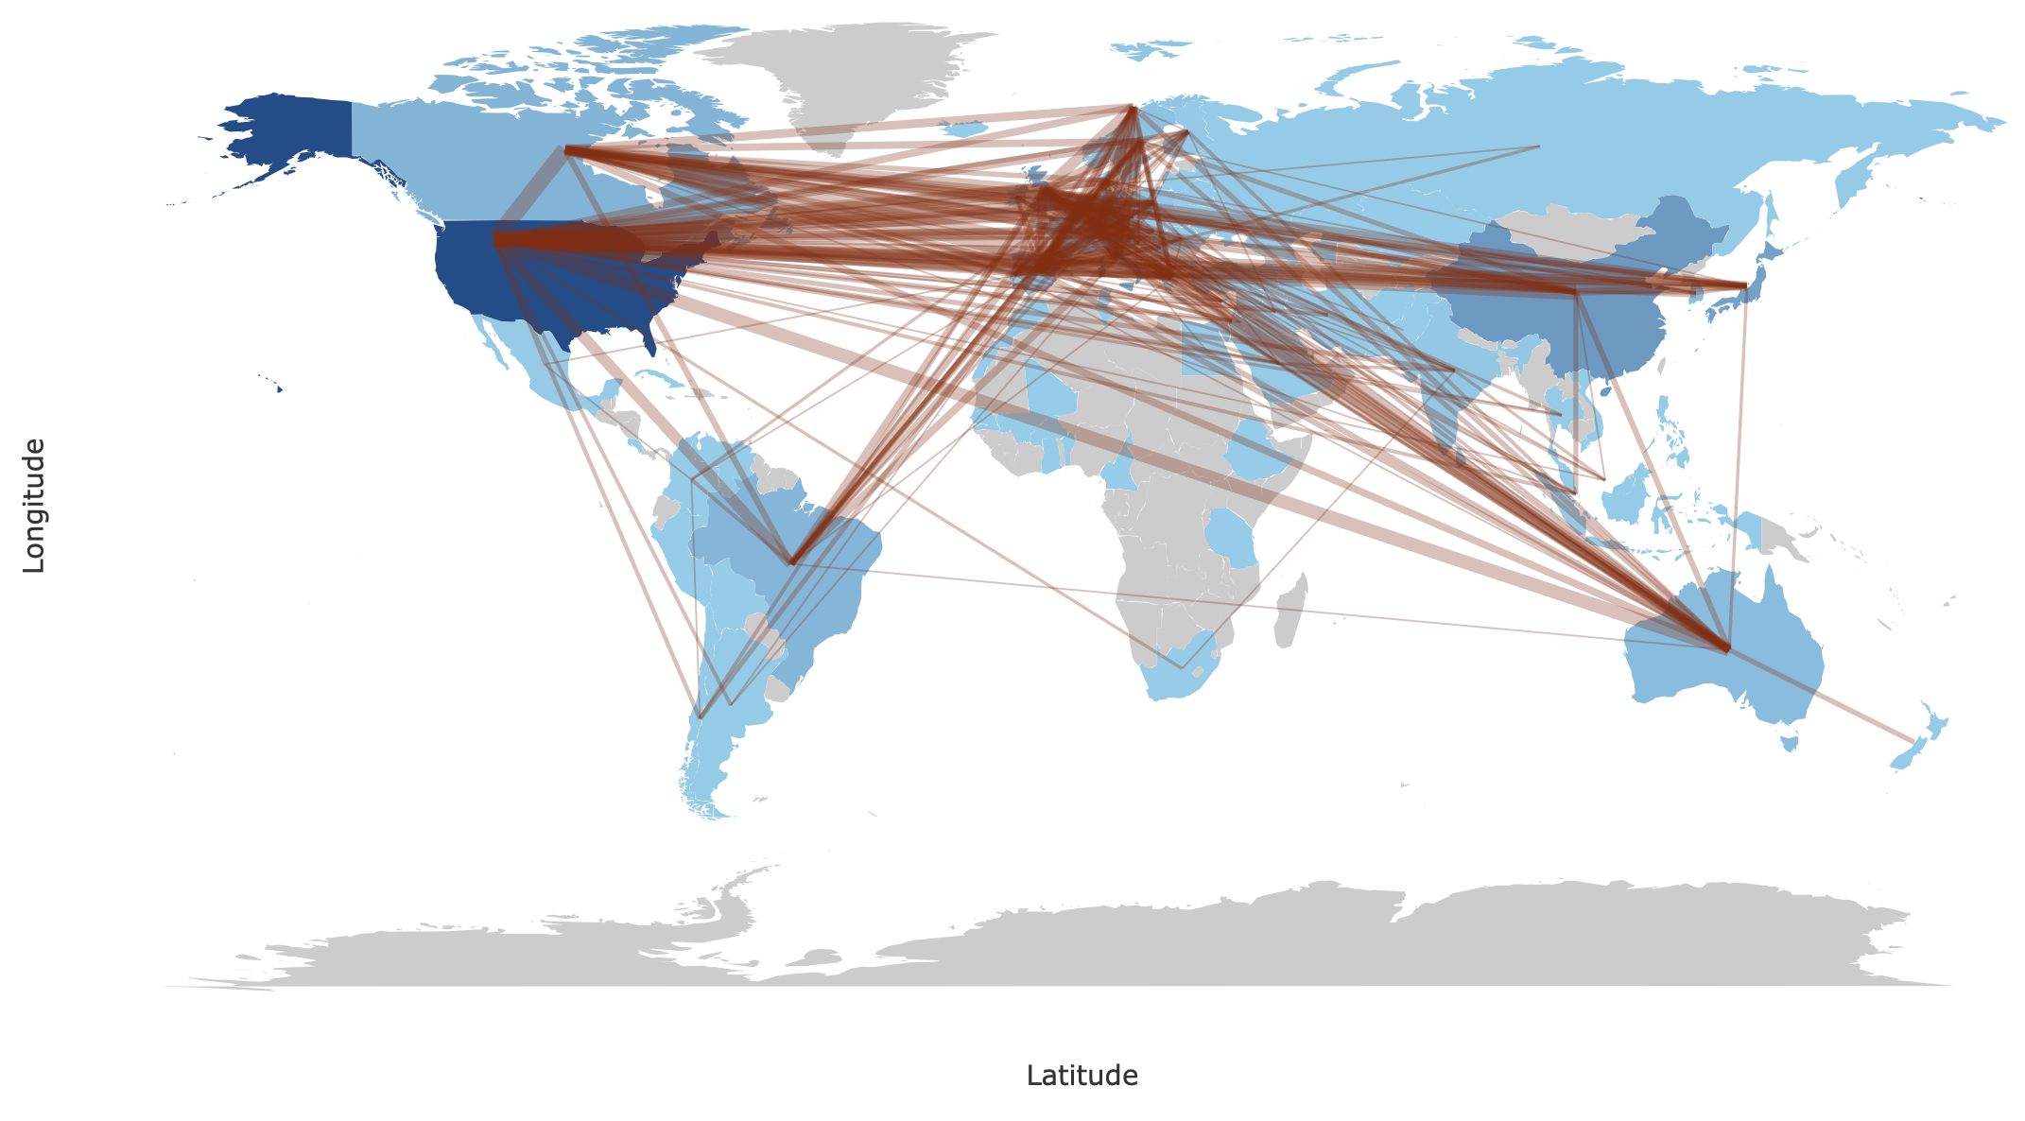
Countries' Collaboration World Map

Slide 31
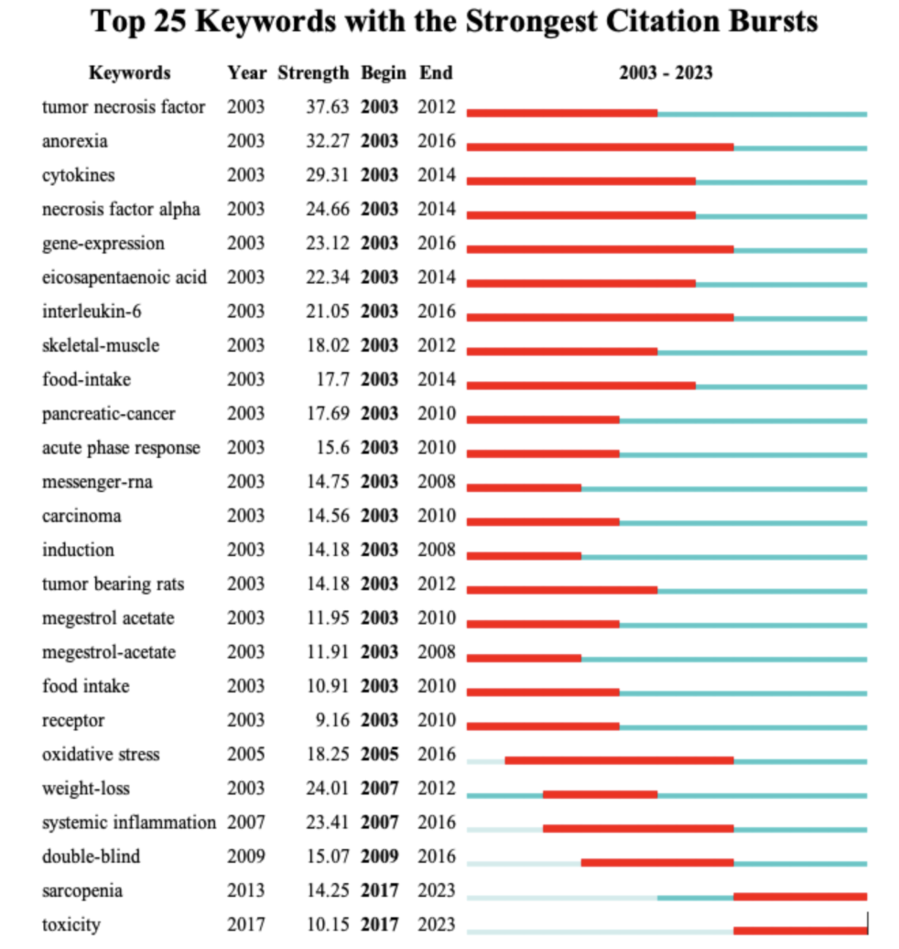
Burst Analysis of Keywords from CiteSpace

